Slide 1
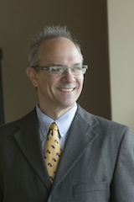
TREATs – Translational Research Ethics: Applied Topics
Presented by the Bioethics and Subject Advocacy Program (BSAP) of the Indiana Clinical and Translational Science Institute (CTSI)
“Medical Students as Research Subjects”
Thursday, December 5th, 2024
12-1 PM
Live streaming at: https://iu.zoom.us/j/83757292369
Andrew O. Brightman, PhD
Professor of Engineering Practice
Weldon School of Biomedical Engineering
Purdue University
For any questions, please contact Nic Oliver, Program Manager, at the IU Center for Bioethics at olivnj@iu.edu

Slide 2
Medical Students as Research Subjects
Agenda:
A Study of Medical Students as Research Subjects
Special Considerations for Medical Students
Ethics Guidance
Q & A

Slide 3
Medical Students as Research Subjects
Tater et al. 2024 - A study of evaluation and research requests to medical students in New Zealand:
Two pre-clinical student cohorts were surveyed (aggregated response rate 28%, n=167)
In one year, they received 42 and 34 evaluation requests
And 8 and 10 research requests, respectively.
70% felt they received too many evaluation requests
76% indicated program evaluation request volume should be limited,
and 30% indicated receiving program evaluation requests was ‘a little stressful’
Tater, J., Zaharic, T., Guy, W., & Cornwall, J. (2024). How much is too much? Medical students’ perceptions of evaluation and research requests, and suggestions for practice. Assessment & Evaluation in Higher Education, 49(1), 117-128.
Notes:
Preclinical medical students
The online survey included questions about request frequency, volume, and timing.
The University of Otago is a research-intensive tertiary institution located in Dunedin, New Zealand.
The Bachelor of Surgery and Bachelor of Medicine (MB ChB) degree is a six-year, undergraduate course with 300 students per cohort/year located on the same campus for the first two years (pre-clinical).

Slide 4
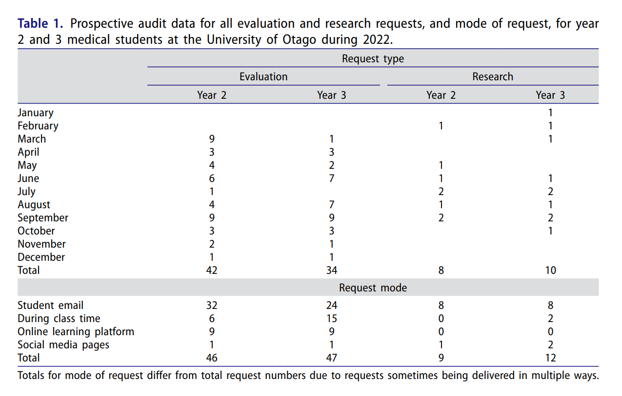
Medical Students as Research Subjects
Notes:
Preclinical medical students
The online survey included questions about request frequency, volume, and timing.
The University of Otago is a research-intensive tertiary institution located in Dunedin, New Zealand.
The Bachelor of Surgery and Bachelor of Medicine (MB ChB) degree is a six-year, undergraduate course with 300 students per cohort/year located on the same campus for the first two years (pre-clinical).

Slide 5
Medical Students as Research Subjects
Perceptions of Evaluation VS. Research Requests:
Students viewed research requests differently to evaluation requests
They were more likely to engage with research (44%) than evaluation requests (27%)
23% stated they had no real interest in engaging with evaluation compared to 6% for research requests
Students felt they received too many evaluation requests (70%) compared to too many research requests (12%)
Students were more likely to rate their first reaction to receiving an evaluation request as stressful (31%) compared to when research requests were received (20%)
Notes:
Preclinical medical students
The online survey included questions about request frequency, volume, and timing.
The University of Otago is a research-intensive tertiary institution located in Dunedin, New Zealand.
The Bachelor of Surgery and Bachelor of Medicine (MB ChB) degree is a six-year, undergraduate course with 300 students per cohort/year located on the same campus for the first two years (pre-clinical).

Slide 6
Medical Students as Research Subjects
Special Considerations for Medical Students:
Students are an accessible Human Subjects Research population
Students need to be considered a vulnerable HSR population
Students can benefit, and benefit from, participation in research
Notes:
Human (adult) participants are essential in translational research
HSR Participants require ethical protection
Vulnerable participant populations require special protections

Slide 7
Medical Students as Research Subjects
Medical Students as a Vulnerable Population:
In Beyond Consent, Seeking Justice in Research, the authors ponder the many challenges of vulnerable populations as research subjects:
Clinical research is a complex, expensive, and valued social activity
A subject population that is convenient, both in terms of recruitment availability…and monitoring through the course of the study… makes clinical research more feasible
Medical students seem to occupy a middle ground between short-term hospitalized patients and long-term prisoners
Among the ways that students differ from general population is their availability, the greater likelihood that they…can be coerced or manipulated into participation by virtue of their dependent status
Moreno, J.D., Convenient and Captive Populations, (1998) in Beyond Consent, Seeking Justice in Research, (Jeffrey P. Kahn et al. Ed.) Oxford University Press, p. 111. Page 17 in Human Subject in Research U. Mass, Amherst
Notes:
Human (adult) participants are essential in translational research
HSR Participants require ethical protection
Vulnerable participant populations require special protections

Slide 8
Medical Students as Research Subjects
Medical Students as a Vulnerable Population:
Medical students have described a sense of professional responsibility to participate in research (Devine et al. 2019)
Because medical students understand the importance of research, they are often willing to participate in surveys and other research studies with no more than minimal risk
However, because they are first and foremost students, it is important to protect their role and priorities as learners
To ensure students can prioritize time for coursework, a few medical schools require additional review by the Associate Dean of Medical Education for protocols seeking to recruit medical students as participants. (Boonshoft School of Medicine)
Notes:
Devine, L., S. Ginsburg, T. Stenfors, … & L. Stroud (2019). Professional Responsibilities and Personal impacts: Residents’ Experiences as Participants in Education Research. Academic Medicine: Journal of the Association of American Medical Colleges, 94 (1): 115–121
Review of Expected time commitment for participant involvement

Slide 9
Medical Students as Research Subjects
Medical students can benefit from HSR participation:
Benefit their understanding of HSR generally – its challenges and its role in improving medicine
Benefit their own education and can improve future medical training (Stephenson et al., 2019)
Benefit their specific understanding of distinctions of clinical / biomedical / educational research
Benefit their potential future research involvement or support as they progress professionally
Notes:
Stephenson, E. D., Farquhar, D. R., Masood, M. M., ... & Zanation, A. M. (2019). Blinded evaluation of endoscopic skill and instructability after implementation of an endoscopic simulation experience. American Journal of Rhinology & Allergy, 33(6), 681-690.

Slide 10
Medical Students as Research Subjects
Potential Positive and Negative Impact on Studies:
Medical education and training may increase the student’s understanding of risk and consent
Medical education may increase the student’s compliance with research protocols
Participation fatigue may reduce the student’s compliance or increase drop-out from studies

Slide 11
Medical Students as Research Subjects
Question:
Do medical students need additional (special) protections? (Christakis,1985 – Harvard Medical School)
Some early requirements were so restrictive so as to prevent most studies from using students
Typically required double review by both medical school and study site hospital IRB
All students received policy statement at the beginning of each year as to participation
Student health and well-being were considered as priorities along with time constraints
Payment for participation was restricted due to the large debt of most medical students
Notes:
health and well-being were considered so a special medical exam was a requirement for most clinical studies

Slide 12
Medical Students as Research Subjects
Question:
Some changes proposed to the special protections (Christakis,1985 – Harvard Medical School)
Changes seek to eliminate the perceived paternalistic attitude of the policies
Changes seek to eliminate the double (standard) review of protocols
Treat medical students as responsible autonomous adults and utilize the same standards for review as with all adult populations
Notes:
Christakis, N. (1985). Do medical student research subjects need special protection?. IRB: Ethics & Human Research, 7(3), 1-4.

Slide 13
Medical Students as Research Subjects
Ethics Guidance: IUSM Guidance (May 2024)
Recruitment of students into a study by their instructor has the potential to be coercive. For this reason, teachers should not use their own students as subjects in their research if it can be avoided.
2. When researchers do wish to enroll their own students in research and the participation involves students completing extra-curricular activities, the researcher is required to obtain permission from their students, and additional steps should be taken to prevent the students from feeling coerced into participating.

Slide 14
Medical Students as Research Subjects
Ethics Guidance: IUSM Guidance (May 2024)
3. The researcher should arrange to have the permissions and data collected in such a way that they will not know which students are participating and will not have access to data that indicates participation, until the final grades have been entered.
4. If some course credit is offered in exchange for participation, an alternate means of earning equivalent credit for an equivalent commitment of time and effort should be made available to all potential student subjects. These alternatives must be carefully reviewed to make sure that students are not being coerced into becoming subjects.

Slide 15
Medical Students as Research Subjects
Ethics Guidance:
Are these protections sufficient for medical students to participate in research?
Notes:
Christakis, N. (1985). Do medical student research subjects need special protection?. IRB: Ethics & Human Research, 7(3), 1-4.

Slide 16
Ethics Guidance - Other Institutions: Univ. of Pittsburgh
Given the heavy curriculum burden on medical students, the School of Medicine has developed a specific policy for their enrollment into research protocols.
A proposed research plan must be must reviewed by the Research on Medical Students (ROMS) Review Committee before it can be submitted to the IRB.
The goal of this additional review is to balance the needs of researchers with the interests and availability of the medical students.
A medical student may not be required to participate in research for course credit. For optional course or extra credit, in all cases, a comparable non-research alternative must be offered.

Slide 17
Ethics Guidance - Other Institutions: Univ. of Pittsburgh
To minimize the potential for coercion, alternatives to participating in research must be comparable in terms of time, effort, and fulfillment of requirements.
All students must be free to withdraw from participation at any point in a study without penalty. Students who withdraw must receive full credit for participation.
Recruitment must be designed to minimize the possibility of undue influence. Potential participants should be solicited from a “broad base” of individuals meeting the conditions for study, rather than by personal solicitation of specific students.
Except in unusual circumstances, investigators should not enroll students from their own classes when the research involves greater than minimal risk without the prospect of direct benefit.

Slide 18
Medical Students as Research Subjects
Ethics Guidance: 12 Basic Recommendations
(Boileau, E., Patenaude, J., & St-Onge, C. (2018). Twelve tips to avoid ethical pitfalls when recruiting students as subjects in medical education research. Medical Teacher, 40(1), 20-25.)
Determine if the study is evaluation or research – based on intended use and audience for findings
Verify need for consent for secondary use of data – typically based on level of identifiable information
Inform students of all privacy and consent measures – to reduce potential for coercion or biased responses
Obtain consent by an independent team member - to reduce COI and coercion in recruitment & consent
Notes:
Boileau, E., Patenaude, J., & St-Onge, C. (2018). Twelve tips to avoid ethical pitfalls when recruiting students as subjects in medical education research. Medical Teacher, 40(1), 20-25.
.
based on level of identifiable information - may fall under FERPA and consent required…
an independent recruitment could be by research participant management software…

Slide 19
Medical Students as Research Subjects
Ethics Guidance: 12 Basic Recommendations
(Boileau, E., Patenaude, J., & St-Onge, C. (2018). Twelve tips to avoid ethical pitfalls when recruiting students as subjects in medical education research. Medical Teacher, 40(1), 20-25.)
Ensure participation remains confidential throughout – esp. as cohort size decreases and stakes increase
Limit personal data collection and anonymize data – or de-identify information before release to faculty
Protect again any possible re-identification of data – esp. with small cohorts and strict inclusion criteria
Protect again any possible unauthorized data access - esp. secure digital data, to ensure trust in research
Notes:
Boileau, E., Patenaude, J., & St-Onge, C. (2018). Twelve tips to avoid ethical pitfalls when recruiting students as subjects in medical education research. Medical Teacher, 40(1), 20-25.
Personal information - may be embarrassing or sensitive for students even if not seem so to researchers…
Use only well established and verified research participant management software…

Slide 20
Medical Students as Research Subjects
Ethics Guidance: 12 Basic Recommendations
(Boileau, E., Patenaude, J., & St-Onge, C. (2018). Twelve tips to avoid ethical pitfalls when recruiting students as subjects in medical education research. Medical Teacher, 40(1), 20-25.)
Avoid making study part of mandatory training – avoids full consent and may prove harmful to some
Consider using breaks in mandatory training – decreases stress and increased participation
Avoid offering course credit for participation – complicates consent, coercion, and selection bias
Seek review by an education research committee - such committees are rare, but can supplement IRB
Notes:
complicates consent, coercion, and selection bias – likely to attract students with academic challenges inducing a bias in data
education research committees are rare = survey of four main medical education journals found that only 5% of research had been reviewed by ERC (Hally & Walsh 2016
IRBs also may expedite review and not consider specific issues related to medical students…

Slide 21
Medical Students as Research Subjects
Q & A:
Special Considerations for Medical Students as Research Participants, yes, no, maybe?

Slide 22
References:
Christakis, N. (1985). Do medical student research subjects need special protection?. IRB: Ethics & Human Research, 7(3), 1-4.
Sarpel, U., Hopkins, M., More, F., Yavner, S., Pusic, M., Nick, M., ... & Kalet, A. (2013). Medical students as human subjects in educational research. Medical Education Online, 18(1), 19524.
Hally, E., & Walsh, K. (2016). Research ethics and medical education. Medical teacher, 38(1), 105-106.
Boileau, E., Patenaude, J., & St-Onge, C. (2018). Twelve tips to avoid ethical pitfalls when recruiting students as subjects in medical education research. Medical Teacher, 40(1), 20-25.
Stephenson, E. D., Farquhar, D. R., Masood, M. M., ... & Zanation, A. M. (2019). Blinded evaluation of endoscopic skill and instructability after implementation of an endoscopic simulation experience. American Journal of Rhinology & Allergy, 33(6), 681-690.
Devine, L., S. Ginsburg, T. Stenfors, … & L. Stroud (2019). Professional Responsibilities and Personal impacts: Residents’ Experiences as Participants in Education Research. Academic Medicine: Journal of the Association of American Medical Colleges, 94 (1): 115–121
Awad, M. M., Kaji, A. H., & Pawlik, T. M. (2024). Practical Guide to Ethics in Surgical Education Research. JAMA surgery.
Tater, J., Zaharic, T., Guy, W., & Cornwall, J. (2024). How much is too much? Medical students’ perceptions of evaluation and research requests, and suggestions for practice. Assessment & Evaluation in Higher Education, 49(1), 117-128.

Slide 23
Advice and Consulting on Ethics Considerations for Translational Research
Center for Bioethics
Bioethics and Subject Advocacy Program (BSAP)
https://bioethics.iu.edu/ethics-research/request-consult.html
Contact: Nic Oliver, Program Manager at olivnj@iu.edu
Indiana CTSI
Think Tank (Medical Technologies)
https://indianactsi.org/researchers/services-tools/think-tank/
Contact: Dr. Kara Garcia, Navigator at karagarc@iu.edu

