Slide 1
Who decides the value of new genomic technologies for rare disease?
Bioethics Grand Rounds School Of Medicine Indiana University
March 13, 2025
Meghan Halley, PhD, MPH
Assistant Professor of Pediatrics
Center for Biomedical Ethics
Stanford University School of Medicine
Notes:
Hello everyone, My name is Meghan Halley, and I am a medical anthropologist and senior research scholar at the Center for Biomedical Ethics at Stanford University.
It is such a pleasure to be here today to discuss the topic of patient-centered approaches to undiagnosed diseases

Slide 2
Disclosures
I have no financial conflicts of interest to disclose
Affiliations
Co-chair, Rare Disease Advisory Panel, Patient Centered Outcomes Research Institute
Committee Member, Secretary’s Advisory Committee on Human Research Protections
Co-founder and Board Member Emeritus, Undiagnosed Diseases Network Foundation
Ad Hoc Committee Member, The National Academies of Sciences, Engineering and Medicine
Notes:
Unfortunately no financial disclosures
I do sit on a number of committees but my views do not represent these orgs

Slide 3
Plan for Today
Diagnostic Sequencing
Notes:
I will spend the majority of my time today talking about the work related to myK01
which is focused on understanding the value of genomic sequencing for rare disease diagnosis
using an equity lens in all aspects of my work

Slide 4
Plan for Today
Diagnostic Sequencing
Gene Therapy
Notes:
Then I want to present just a smidge on from our ongoing study on value in gene therapies

Slide 5
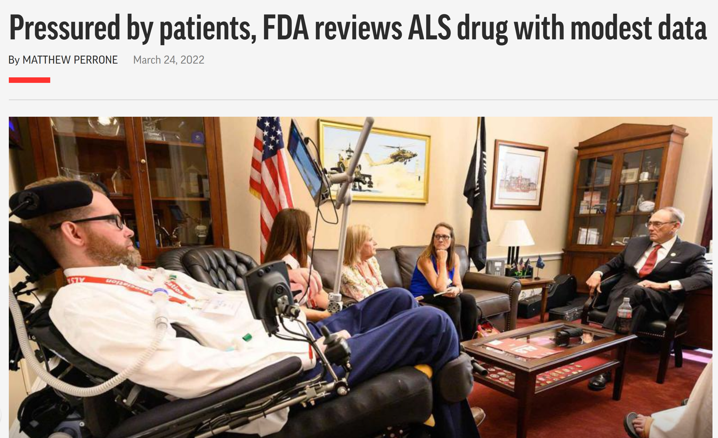
Plan for Today
Diagnostic Sequencing
Gene Therapy
Patient Advocacy
Notes:
That is also relevant for my next project – or at least my next grant -
I will wrap up with a brief overview of this planned work, will focus on the ethics of patient engagement in rare disease research and policy.

Slide 6
Decreasing cost and increasing availability of sequencing
Notes:
The scientific advances in genomics sequencing have arguably created a newly visible patient community, now commonly referred to as “undiagnosed.”
Right- PubMed papers containing the term “undiagnosed” from 2000 to 2021
Left – Data from Google trends is mapping the overall interest in the term “undiagnosed" from 2004 to 2021.
I like these visuals because they provide an clear picture of the increasing interest undiagnosed disease in both the scientific and public spheres.
This term is increasingly in used but lack of precision can cause confusion
I think a kid like Mitchell, who you will hear about from Michelle, is what you typically think about as a patient with an undiagnosed condition.
But its meaning is not always so clear-cut

Slide 7
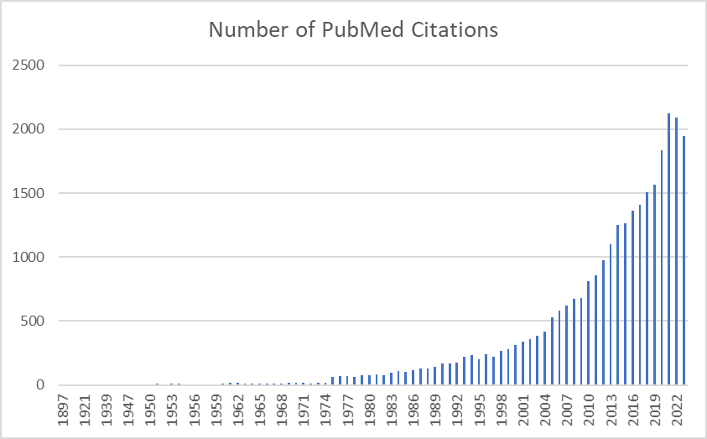
Increasing Interest in the "Undiagnosed"
Notes:
The scientific advances in genomics sequencing have arguably created a newly visible patient community, now commonly referred to as “undiagnosed.”
Right- PubMed papers containing the term “undiagnosed” from 2000 to 2021
Left – Data from Google trends is mapping the overall interest in the term “undiagnosed" from 2004 to 2021.
I like these visuals because they provide an clear picture of the increasing interest undiagnosed disease in both the scientific and public spheres.
This term is increasingly in used but lack of precision can cause confusion
I think a kid like Mitchell, who you will hear about from Michelle, is what you typically think about as a patient with an undiagnosed condition.
But its meaning is not always so clear-cut

Slide 8
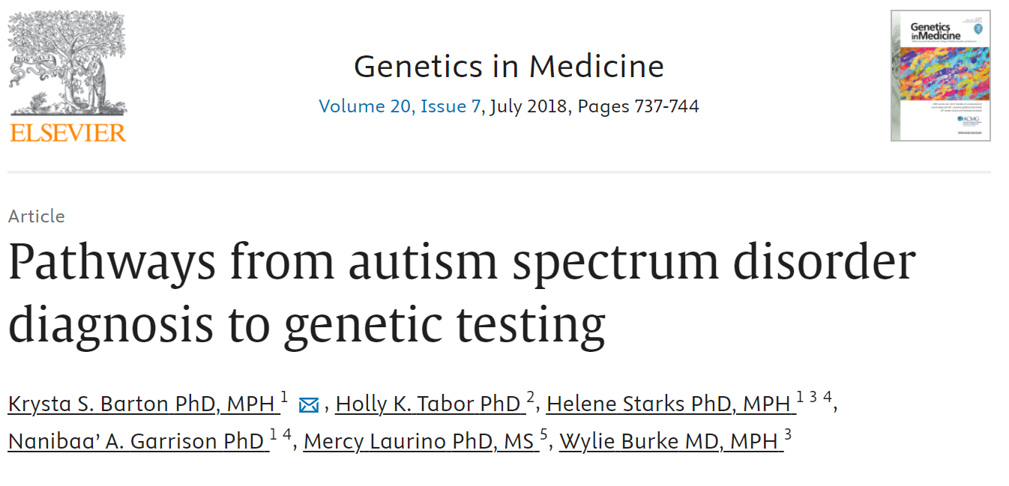
Who are the undiagnosed?
Notes:
What do we mean when we say "undiagnosed?
We could just say "anyone in the undiagnosed diseases network" but it's a bit more complicated than that.
Many of these patients have one or many clinical diagnoses – we know WHAT is happening – but we don't have an etiological diagnosis – the why
Here you can think of patients with idiopathic epilepsy or intellectual disability.
But what about children with autism – are they "undiagnosed"?
We seem to treat some clinical diagnoses as incomplete, but others not so.
Biliary atresia is another example of a condition for which the etiology is unknown, but the patients are not treated as undiagnosed
And then we have conditions like Charcot-Marie-Tooth and Porphyria, where the expansion of genetic testing is increasingly identifying subtypes by genotype, raising the question of whether either is a single disease in and of itself.
In addition, as patients are increasingly receiving genetic diagnoses, patients with these diseases who previous felt that had been diagnosed now report being as if something has been taken away – that they were un-diagnosed.
And don't even get me started on patients who have lived with a diagnosis of CP for years, who finally receive genetic testing only to learn that they have a rare genetic condition.
Long story long – the meaning of "undiagnosed" is more complex than meets the eye.
And using a broad definition, it is almost certain that all of you have encountered "undiagnosed patients in your clinical practice, though neither you nor the patient may have been aware of it.

Slide 9
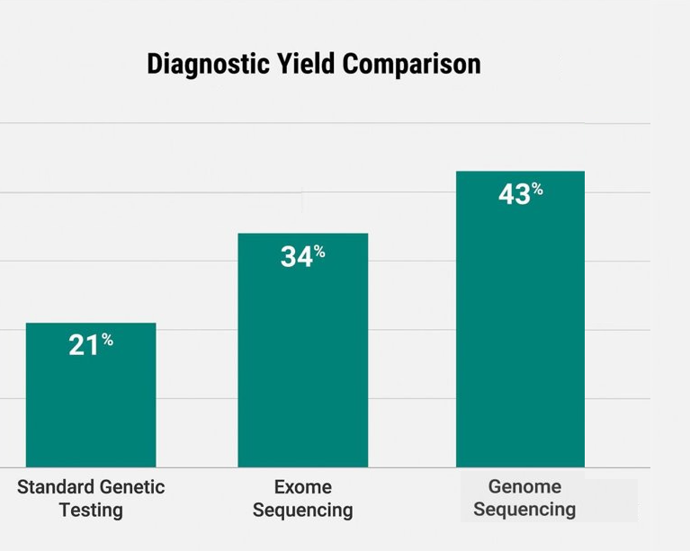
Sequencing for Rare Disease Diagnosis
Notes:
I do not want to give you the impression that access to genetic testing is not the only important factor in diagnosis.
And, as of 2014, an estimated 50% remain undiagnosed even after exhaustive clinical and genetic evaluation
But that was before exome and genome sequencing became more widely available
Given the ability of these technologies to broadly examine the genome, its not surprising that they have a higher diagnostic yield than more targeted approaches
And which the ACMG now "strongly recommends" for patients with suspected rare conditions

Slide 10
Payer coverage of exome and genome sequencing
For Payers:
Value = More health (QALYs) for equal or less cost
(Douglas et al. 2019; Phillips et al. 2022)
Notes:
But payer coverage of sequencing has lagged, such that in 2021 just over half of patients had access to sequencing as a covered benefit, with significant differences between coverage among public and private payers.
Payers argue that because most rare diseases lack therapeutic options, sequencing is unlikely to change clinical management or outcomes.
CLICK - For payers – the value of a new technology is narrowly defined based on improvement in health - as measured by a quality-adjusted life year (QALY) – and net costs.

Slide 11
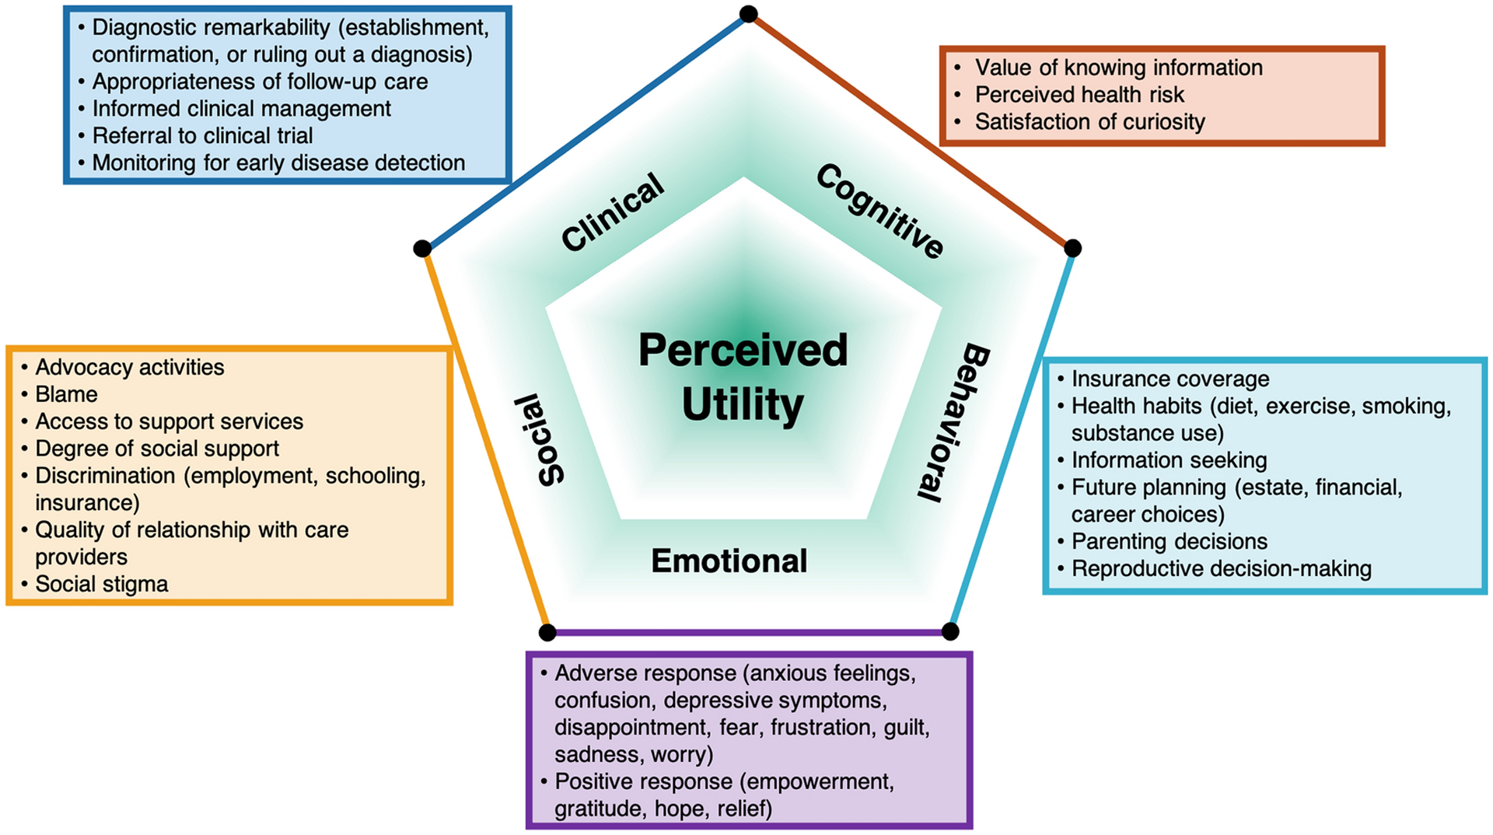
Conceptual model of perceived utility of genetic information
(Smith et al. 2022)
Notes:
A number of studies have proposed models of perceived utility
This is from Hadley Stevens Smith and colleagues from 2022
And it includes a long list of components making up this concept of perceived utility
Including clinical benefits – informing clinical management
Cognitive – value of knowing
Behavioral – reproductive DM
Emotional – relieving guilt

Slide 12
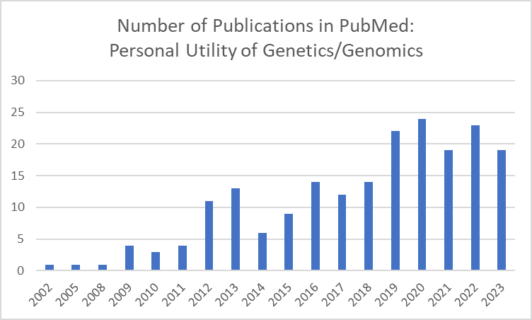
Toward a broader model of value: Personal/perceived utility
Notes:
The interest in personal utility has grown rapidly
However, these studies have largely suffered from weak studies designs, including cross-sectional surveys of patients views at one point in time.
They also largely lack a comparison group of parents of undiagnosed children who did not receive a diagnosis
Further, the studies tended to focus on outcomes directly tied to receiving genetic information and do not include information on changes in patient health outcomes or quality of life more broadly.

Slide 13
Limits of understanding perceived utility
Methodological limitations
Cross-sectional
Lack of control
Focus on proximal outcomes
Predictors of perceived utility
Epistemic limitations
Impact of different diagnoses
Impact on undiagnosed
Notes:
However, there are still limitations in our understanding of personal utility
these studies have largely suffered from weak studies designs, including cross-sectional surveys of patients views at one point in time.
They also largely lack a comparison group of parents of undiagnosed children who did not receive a diagnosis
Further, the studies tended to focus on outcomes directly tied to receiving genetic information and do not include information on changes in patient health outcomes or quality of life more broadly.

Slide 14
Two Studies with Undiagnosed Patients and Families
The UDN Diversity Pilot
Parents of children enrolled in the UDN
Criterion sampling for race and ethnicity
Single in-depth interview
The ValueSeq Study
Parents of undiagnosed children
Purposive sampling for variation
Multiple data collection methods
Data collection at three timepoints
Prior to results received
Return of results
6 months post return of results

Slide 15
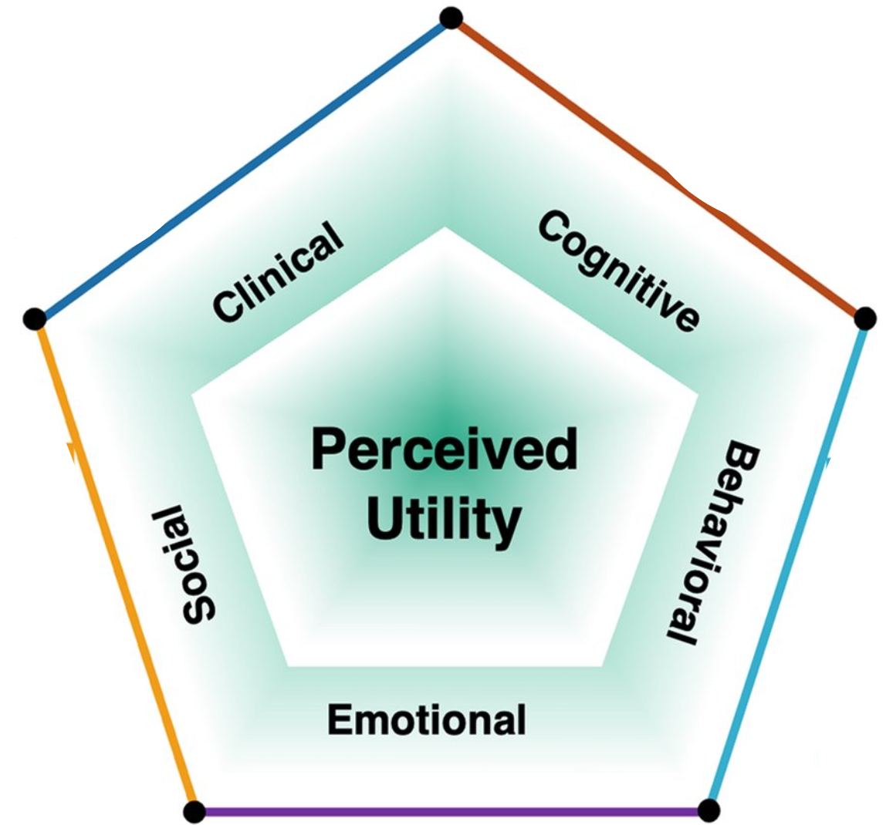
Mediating Factors?
Diagnosed
Baseline Characteristics?
Patient
Parent
Family
Context
GS
Undiagnosed
Pathways to Value
Notes:
But in examining how parents talked about their search for diagnosis, they also expressed a deeper, existential value insomuch as they saw their search for diagnosis as part of what it meant for them to be a good parent who provided their child with their best life possible.

Slide 16
Baseline Characteristics
Parent
Hope for treatment
Value of information
Feelings of guilt
Social isolation
Tolerance of uncertainty
Health literacy
Altruism
Mediating Factors?
Diagnosed
Family
Family planning needs
Socioeconomic status
GS
Child
Child's medical stability
Length of diagnostic odyssey
Undiagnosed
Healthcare and Services
Healthcare access
Access to services
Educational challenges
Care coordination
Doc-patient relationship
Pathways to Value
Notes:
But in examining how parents talked about their search for diagnosis, they also expressed a deeper, existential value insomuch as they saw their search for diagnosis as part of what it meant for them to be a good parent who provided their child with their best life possible.

Slide 17
Medical Stability
I think what’s helped me come to terms with not having an actual genetic answer...is that physically overall he’s really healthy. He can walk, he can do things. (P38)
If you asked me the same question two years ago, I would say, 'Oh my god, we need to find out now!' But right now, with him being so stable, I don't have the urgency. (P27)
Notes:
Another parent noted that their perception of the value of sequencing was contingent on how medically stable their child was at the time.
She says: READ QUOTE
This issue of clinical stability was raised by a number of parents,
but it not so much related to their expectation of sequencing to change health outcomes
but moreso the extent to which medical instability increased their overall stress related to their child's illness.

Slide 18
Tolerance for Uncertainty
I think if we receive a diagnosis, I think there will be relief. I think no matter what the diagnosis is, there’s going to be relief in having an answer because we’re so uncertain right now. (P41)
I think what’s helped me come to terms with not having an actual genetic answer...is that physically overall he’s really healthy. He can walk, he can do things. (P38)
Notes:
While the value of a diagnosis generally did not appear contingent on its clinical impacts, it was described as contingent based on a range of other factors.
including characteristics of the patient, child, and family, as well as on their access to care generally the specific disease diagnosed, and the way in which results were communicated.
For example, this parent described how the value of a diagnosis changed over the course of their diagnostic odyssey, explaining that, when her intial results came back inconclusive, that was pretty hard, but then as time went on, she came to realize that it didn't actually matter because no matter what the diagnosis "Sally will still be Sally"

Slide 19
Healthcare and Support Services
{My son] doesn’t have a special needs stroller, he doesn’t have a special needs car seat, he doesn’t have a bath chair, he doesn’t have an activity chair…he literally has nothing because he doesn’t fall in a bucket that allows [the county] to help him. (P08)
We don’t have a diagnosis and she has [services], and I think the way that we put that into place was based on her seizures and aspiration, so having a diagnosis wouldn’t have changed that. (P05)

Slide 20
Socioeconomic Status?
"I feel like the biggest change was the relationship between us and like her general practitioner…. I felt like they finally took my concerns more ser…like I was no longer that worried first-time mom." Mother, White, English-speaking
"I think even the doctors here…they still keep calling it [multiple sclerosis], or the general term for a neurodegenerative disorder… sometimes they do refer to this certain gene mutation…but it's rare that they even bring it up…"
Mother, Hispanic, Spanish-speaking

Slide 21
Socioeconomic Status?
One of the biggest plus items is finding a group of other families with the same gene and understanding better like where they're at, where we will be at—or could be at." Mother, Asian American, English-speaking
"No, I also don't want to be sent a list of people who have the same illness as my son because I don't want to look at advanced cases and I don't want to watch how my child will die."
Mother, Hispanic, Spanish-speaking

Slide 22
Socioeconomic Status?
"I went ahead and formed a foundation that we’re…just like getting off the ground and we hope to have the first meeting of a small group of researchers…that hopefully will help decide on a research agenda to develop treatments." Father, White, English-speaking
"Since he doesn't have papers or insurance, they can't run some test for him... He doesn't qualify to receive certain aid. Or if there's a program that can help him, that can take care of him for me...well they don't have them." Mother, Hispanic, Spanish-speaking

Slide 23
Notes:
And what started as a small question turned into a much larger project
But I had a really terrific group of mentees who went to work reviewing the literature, and extracting and synthesizing the data.
In the interest of time, I am not going to go over the methods, but they are available in the publication that came out earlier this year.

Slide 24
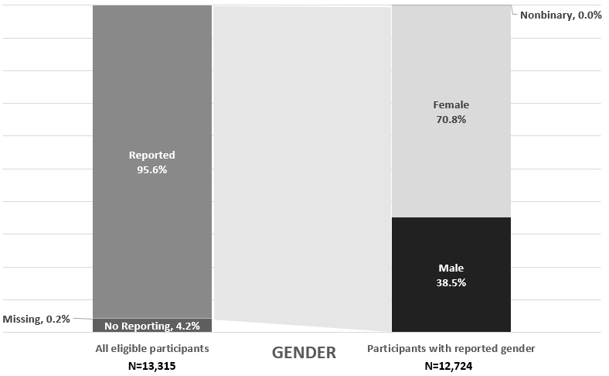
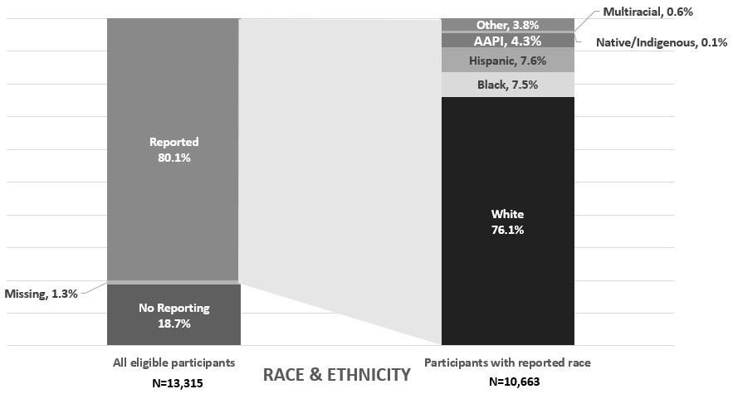
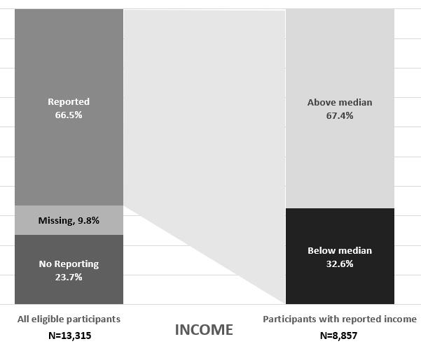
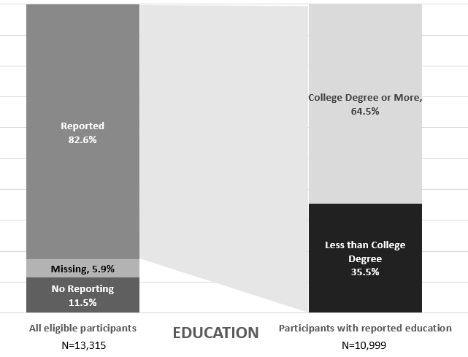
Participant Characteristics
70.8% female
76.1% White
64.5% college educated
69.3% above median income
Notes:
My first reaction when I saw these results was – its not quite as bad as I thought!
Sure only a third of the US population has a bachelors degree, and only 60% of the population identifies as NHW, but it could be worse.
But then...we removed the two studies focused on racial and ethnic diversity, and the mean proportion of White participants increased to over 80%
We noted that there were only 274 Black participants across all quantitative studies of personal utility compared with 7950 White participants.
And near half of the Black participants in all qualitative studies came from a single study specifically focused on the perspectives of Black patients.
And one other thing we noticed – the study focused on Black patient perspectives titled itself as such,
But we reviewed many papers all or neally all White participants, but none were titled "perspectives of White patients.".
This just highlights the way in which we as researchers inadvertently reinforce the notion that White perspectives are the "norm" from which “other” perspectives deviate.

Slide 25
Baseline Characteristics
Parent
Hope for treatment
Value of information
Feelings of guilt
Social isolation
Tolerance of uncertainty
Health literacy
Altruism
Mediating Factors
Specific Diagnosis
Information available
Prognosis
Certainty
Prevalence
Phenotypic variation
Diagnosed
Family
Family planning needs
Socioeconomic status
GS
Testing Process
Wait time for results
Mode of delivery
Clarity of explanations
Post-results follow-up
Quality of communication
Child
Child's medical stability
Length of diagnostic odyssey
Healthcare and Services
Healthcare access
Access to services
Educational challenges
Care coordination
Doc-patient relationship
Pathways to Value
Notes:
But in examining how parents talked about their search for diagnosis, they also expressed a deeper, existential value insomuch as they saw their search for diagnosis as part of what it meant for them to be a good parent who provided their child with their best life possible.

Slide 26
Disease Characteristics
Availability of Information
It’s kind of bittersweet news because finally we have a name for it, but we still don’t have any information about it, it’s just basically the same thing with a name...We are in the same line as bad as we were before. (P27)
Notes:
Parents also noted that value was contingent on some characteristics of the diagnosis itself,
Though their frustration was primarily with the lack of information provided, particularly for exceedingly rare diseases.
Here we have one parent whose child received a diagnosis of an ultra-rare diseases, and she is frustrated at the lack of information the diagnosis brings
While the second parent's child received a diagnosis of a well-known genetic disorder, which comes not only with extensive information about prognosis and additional eligibility for services.

Slide 27
Disease Characteristics
Disease Prevalence and/or Community
October is Down's syndrome month and... they have this whole community ...we don’t have Jack crap for [my child's disease]. It's kind of is like your kid’s not special. Cerebral palsy day people celebrate, Down's syndrome month people celebrate, but nobody has a walk or a t-shirt for [my child's disease]…Recognition, you know? (P18)
Notes:
Parents also noted that value was contingent on some characteristics of the diagnosis itself,
Though their frustration was primarily with the lack of information provided, particularly for exceedingly rare diseases.
Here we have one parent whose child received a diagnosis of an ultra-rare diseases, and she is frustrated at the lack of information the diagnosis brings
While the second parent's child received a diagnosis of a well-known genetic disorder, which comes not only with extensive information about prognosis and additional eligibility for services.

Slide 28
Disease Characteristics
Phenotypic Consistency
Initially when we heard we were very excited and felt like this could really help chart a path...but the more we’ve learned on it, we feel like maybe the other kiddos that have it, they don’t necessarily share as many similarities…we’ve seen more differences in them than we do similarities. (P42)
Notes:
Parents also noted that value was contingent on some characteristics of the diagnosis itself,
Though their frustration was primarily with the lack of information provided, particularly for exceedingly rare diseases.
Here we have one parent whose child received a diagnosis of an ultra-rare diseases, and she is frustrated at the lack of information the diagnosis brings
While the second parent's child received a diagnosis of a well-known genetic disorder, which comes not only with extensive information about prognosis and additional eligibility for services.

Slide 29
Baseline Characteristics
Parent
Hope for treatment
Value of information
Feelings of guilt
Social isolation
Tolerance of uncertainty
Health literacy
Altruism
Mediating Factors
Specific Diagnosis
Information available
Prognosis
Certainty
Prevalence
Phenotypic variation
Diagnosed
Family
Family planning needs
Socioeconomic status
GS
Testing Process
Wait time for results
Mode of delivery
Clarity of explanations
Post-results follow-up
Quality of communication
Child
Child's medical stability
Length of diagnostic odyssey
Undiagnosed
Healthcare and Services
Healthcare access
Access to services
Educational challenges
Care coordination
Doc-patient relationship
Pathways to Value
Notes:
Not all pathways to value go through diagnosis
A number of characteristics of the testing process shaped response to receiving non-diagnostic responses
And characteristics of family's access to healthcare and supports

Slide 30
Not all pathways to value go through diagnosis
Despite not having a diagnosis, I cannot say enough about how great of an opportunity I feel like this [process] has been, and how great the team and the researchers have been as well for us, for [my child] for me mentally, and [for] us as a family just going through the process. (P23)
I feel like I lucked into the benefits that I wanted to get from genetics results. I happened to meet this other mom whose kid happened to have overlapping features, who introduced me to the surgery that I think is really going to benefit [my son] long term. (P24)

Slide 31
Not all pathways to value go through diagnosis
I don’t think that us not knowing a name or a label for it has changed it because I'm not treating a syndrome, I'm treating what comes. She’s got a specialist in every category, probably she'd have a specialist in every category if we knew it. (P20)
​This month her neurologist added cerebral palsy to her diagnosis list because we had just been notified that [speech therapy] was no longer gonna be covered without a diagnosis under our insurance. (P21)

Slide 32
Baseline Characteristics
Parent
Hope for treatment
Value of information
Feelings of guilt
Social isolation
Tolerance of uncertainty
Health literacy
Altruism
Mediating Factors
Specific Diagnosis
Information available
Prognosis
Certainty
Prevalence
Phenotypic variation
Primary Goal
Diagnosed
Family
Family planning needs
Socioeconomic status
GS
Living Their "Best Life"
Testing Process
Wait time for results
Mode of delivery
Clarity of explanations
Post-results follow-up
Quality of communication
Child
Child's medical stability
Length of diagnostic odyssey
Undiagnosed
Healthcare and Services
Healthcare access
Access to services
Educational challenges
Care coordination
Doc-patient relationship
Pathways to Value
Notes:
You may think that I am trying to convince you that a diagnosis for these patients is not actually important
Let me be clear, parent's saw diagnosis as having the potential, at least, to have a range of benefits
That very much aligned with existing understandings of personal utility,
But also didn't capture the whole picture
Yes they saw instrumental value in diagnosis, for access to services or guidance for clinical management
And they even anticipated intrinsic value of knowing
But in examining how parents talked about their search for diagnosis, they also expressed a deeper, existential value insomuch as they saw their search for diagnosis as part of what it meant for them to be a good parent who provided their child with their best life possible.

Slide 33
Living Their Best Life
"If my son has something fatal ...we should not be sitting in our house watching f***ing Mickey Mouse, excuse my language. We should be on a beach in Hawaii, and we should be going to Disneyland, and who cares if he gets COVID because he should live his best life. (P08)
Notes:
Perhaps best illustrated by this participant, who says QUOTE
I don't have to tell you that this is not about Mickey Mouse, COVID, or even about diagnosis
This mom is expressing her need to be able to make fundamental choices about what type of parent she is, and what type of life she gives her child
However, she feels unable to do without some map for the future, which she is hoping will come from diagnosis.
Happy to report that they did get a diagnosis and they did go to Disneyland.

Slide 34
Living Their Best Life
It changes everything, and it changes nothing ...Clinically it’s not going to change much for her, we’re pretty much doing everything we should be doing...The thing that makes me very happy about this diagnosis is it’s not degenerative, that she still will continue to live a long life. (P10)
Notes:
However, the diagnosis did not have to have instrumental value to speak to this idea of giving a child their best life.
Which I think this parent summarizes perfectly when, after her daughter receives a diagnosis, she says that "it changes everything and it changes nothing."
She recognizes the lack of clinical utility – the value is in seeing what her child's future might hold.

Slide 35
Whose defines the value of gene therapies?
Notes:
I want to transition now from teh topic of diagnosis to talk just briefly about how this question of "whose voices matter" can be applied to thinking about how we define and measure the value of gene therapies in rare diseases, and
7 minutes

Slide 36
Pricing Gene Therapies for Rare Diseases
$850,000
Luxturna (Ret Pig) 2017
$2,100,000
Zolgensma (SMA) 2019
$2,800,000
Zynteglo (Beta Thal) 2022
$3,000,000
Skysona (CALD) 2022
$3,500,000
Hemgenix (Hemo B) 2022
$3,200,000
Elevidys (DMD) 2023
$4,250,000
Lenmeldy (MLD) 2024
Notes:
I know I don't have to tell this group about the high prices of gene therapies
These prices are justified based on the argument that the price of these therapies is offset by the dollars saved by avoid other expensive, less effective therapies and, in some cases, improving health outcomes or potentially offering long-term cures.
They and others come to these numbers using a process called value assessment – dollars per increment of benefit – but how is benefit defined? What characteristics make a therapy valuable?

Slide 37
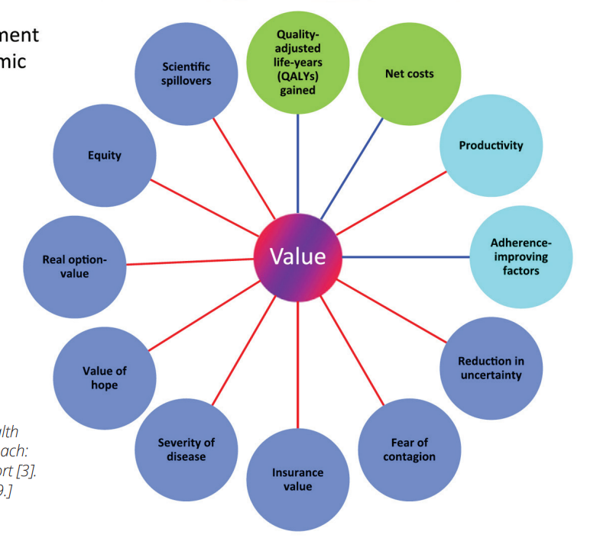
Expanding Value Elements
Increased length of life
Increased quality of life
Reduction in net costs
Family spillover
Ease of administration
Size of patient population
Severity of disease
Bridge to other therapies
Equity
Scientific spillover
(Lakdawalla et al. 2018)
Notes:
They and others come to these numbers using a process called value assessment – dollars per increment of benefit compared to the alternative
But how is benefit defined? What characteristics make a therapy valuable?
Traditional looked only at quality adjusted life years and net costs
But in recent years, in part because of the introduction of gene therapies – both patients orgs and scholars have argued that value is more complex and based on a variety of "value elements"
such as benefits of a therapy to family members or "family spillover", whether it treated a more or less severe disease, or whether it was more likely to mitigate or exacerbate existing inequities in access to healthcare.
The diagram here is called the "value flower" and iis one of many new models for thinking about the range of value elements that are relevant to understanding the relative value of new therapies.

Slide 38
Participant Perspectives
Participants (n=30)
Rank 10 value elements
Relevance to value of gene therapy
Notes:
Using this model, we asked stakeholders working a range of different backgrounds including payers, private healthcare systems, academic medical centers, bioetch, government research and patient organizations
to rank 10 “value elements” in terms of their importance for defining value
I wont' talk about them all here because some are quite complex to explain
But I wanted to highlight just a bit of these data for reasons that will hopefully be clear momentarily
We conducted 30 interviews with individuals working in a range of roles, including patient organizations, government research, private biotech, academic medical centers, private healthcare delivery systems, and public and private payers.

Slide 39
Net Costs: Of Course Payers Care!
“Medicaid gets their budget assigned about a year in advance. So once you have a set budget you have 1-million-dollar products coming to the market, you really have to have a focus on cost… because we could run out of money technically.”
(Payer P29)
Notes:
And we found some things that were not surprising. For example, we weren’t surprised that payers ranked net cost savings as the most important, and higher than all other stakeholders.
As this participant from Medicaid articulates, they have a set budget, and can technically run out of money if a therapy is very expensive and doesn’t also reduce costs of other medical care.

Slide 40
Scientific Spillover: Of Course NIH Cares!
“You’re opening a scientific door….And there are so many examples of rare disease opening the door for what is often many, many more people.”
(Government P19)
Notes:
We also weren’t surprised that the folks from govt agencies – primarily NIH and FDA – ranked scientific spillover much higher than other stakeholders. As this participant states, read quote.

Slide 41
What about equity?
“There are things that could get tossed by the wayside because of an equity issue, and then everyone loses. If you can get to the treatment first and then worry about equity.”
(Government P26)
Notes:
I want to focus in a bit more on closely on equity, which was ranked mid to low by most stakeholders., and specifically the reasons parents/patients gave for their rankings
Here we have a participant from a government research agency who states, read quote
This is only an excerpt of his longer statement, which acknowledges the importance of equity, but also positions it as contradictory or even as a threat to scientific progress.
He then says you have to get to the treatment firs and then worry about equity.

Slide 42
What about equity?
"I think, eventually, when all the other things are met, we're gonna get to equity. I think it's a long time before we get there. I think having the equity conversation now is early when we don't even have the conversation about those that have access that can't get their drugs.”
(Patient P01)
Notes:
We heard similar sentiments from representatives from patient organizations, who said READ QUOTE –
She is also arguing that “equity comes later” and that scientific progress and access for those who can pay should come first.

Slide 43
What about equity?
“Companies will say things like, 'you should go with intrathecal delivery instead of an intra-cisterna magna, because it's a real equity [issue] if you do ICM you're going to need a neurosurgeon to deliver it.' Whereas we (the patients] are thinking - we want the best damn drug that we can get."
(Patient Org P18)
Notes:
But this is concerning because of the ways in which a multitude of decisions made before, during, and after research is funded have equity implications.
Here we have another individual from a patient organization that is working closely with researchers developing a gene therapy for their disease who says READ QUOTE
HI like this quote because I think it nicely illustrates why the idea that “equity comes later” is unlikely to actually achieve equity, as key decisions are made upstream in the design and early development.

Slide 44
Whose voices shape resource allocation in rare disease?

Slide 45
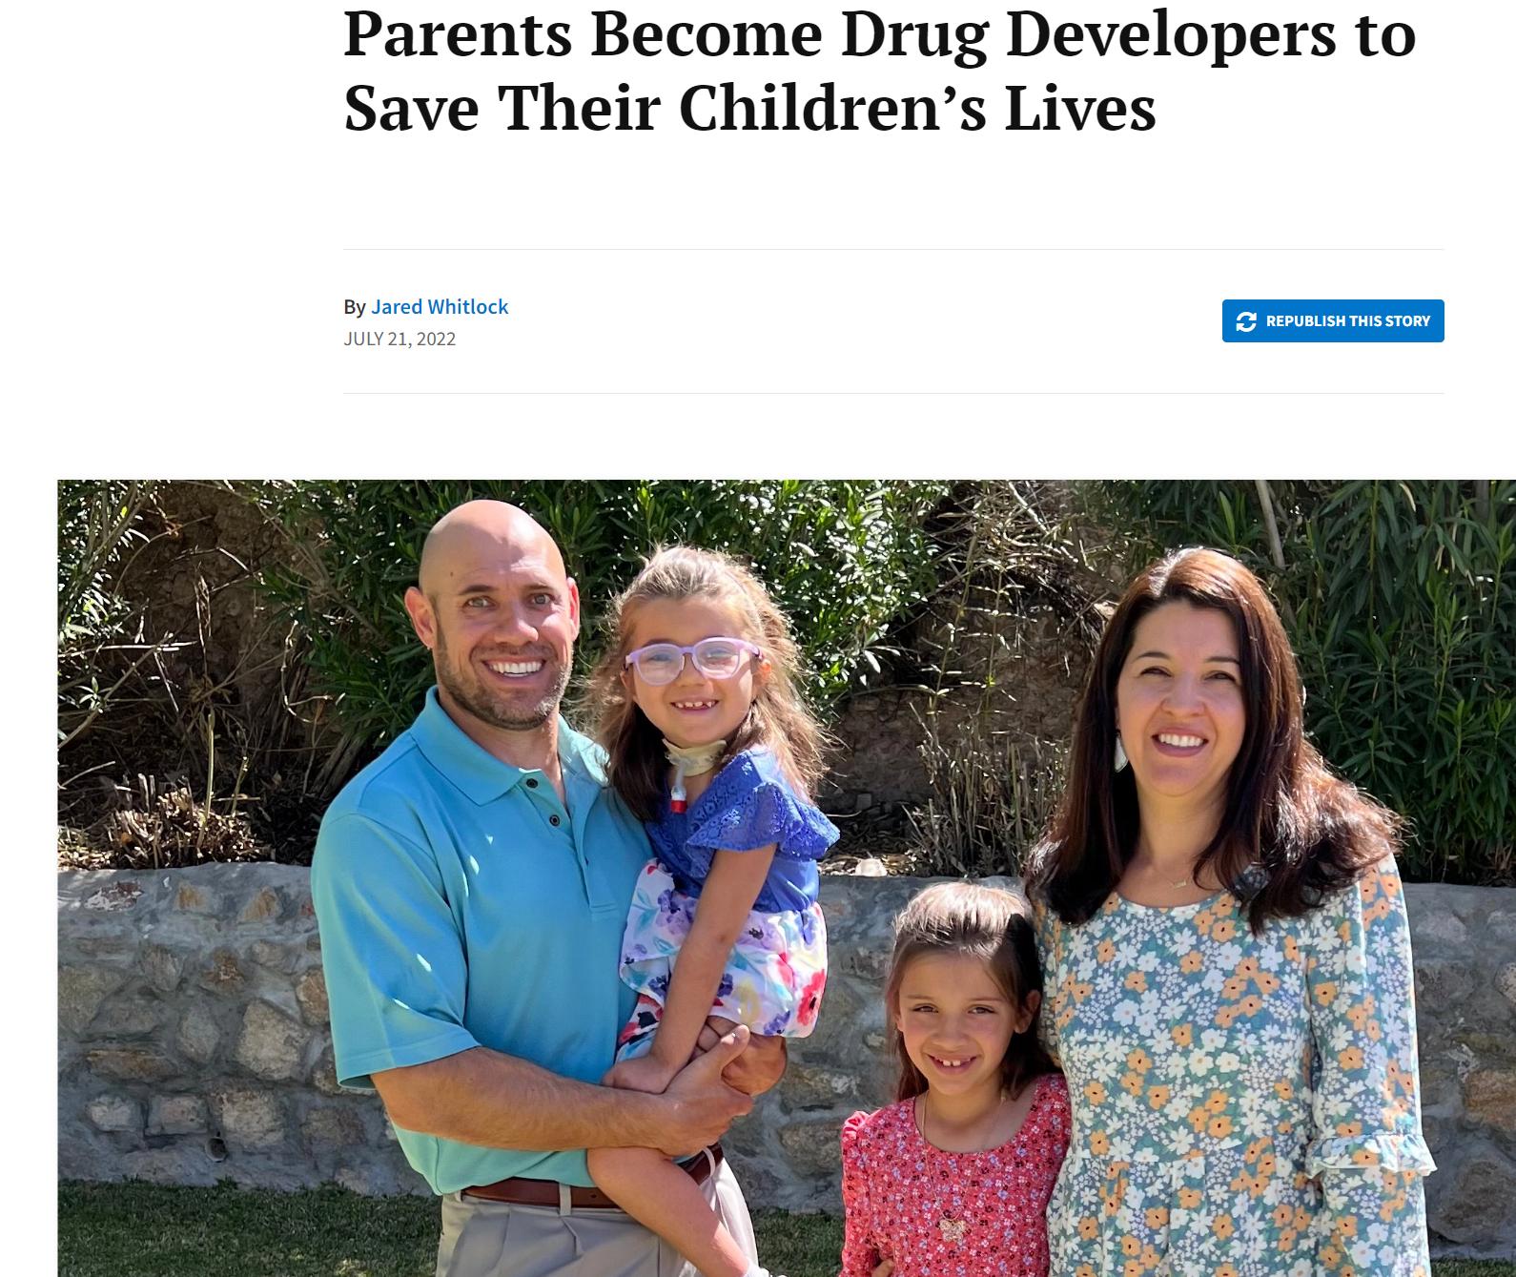
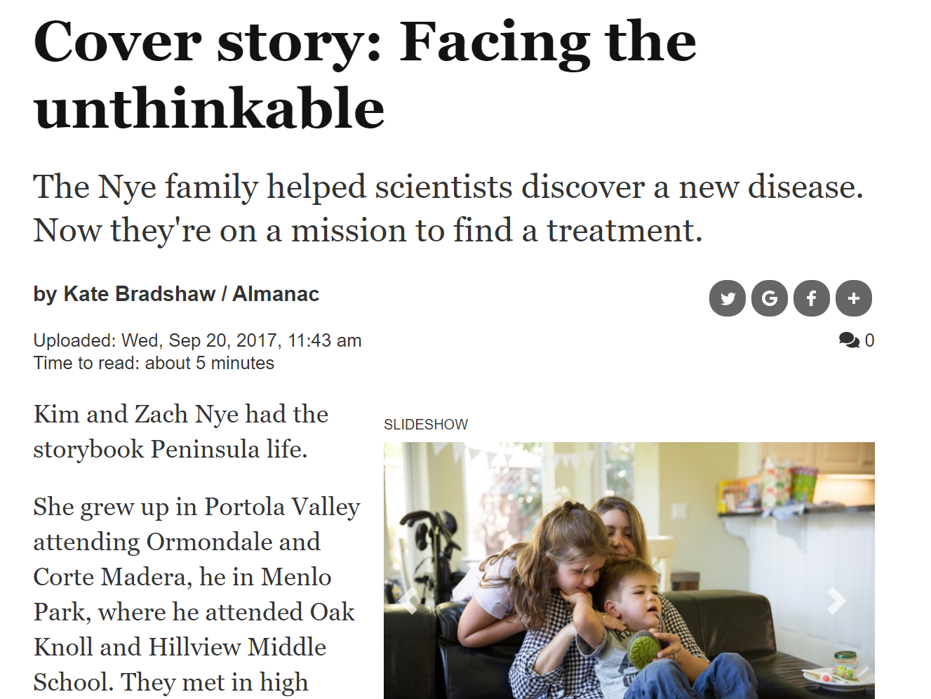
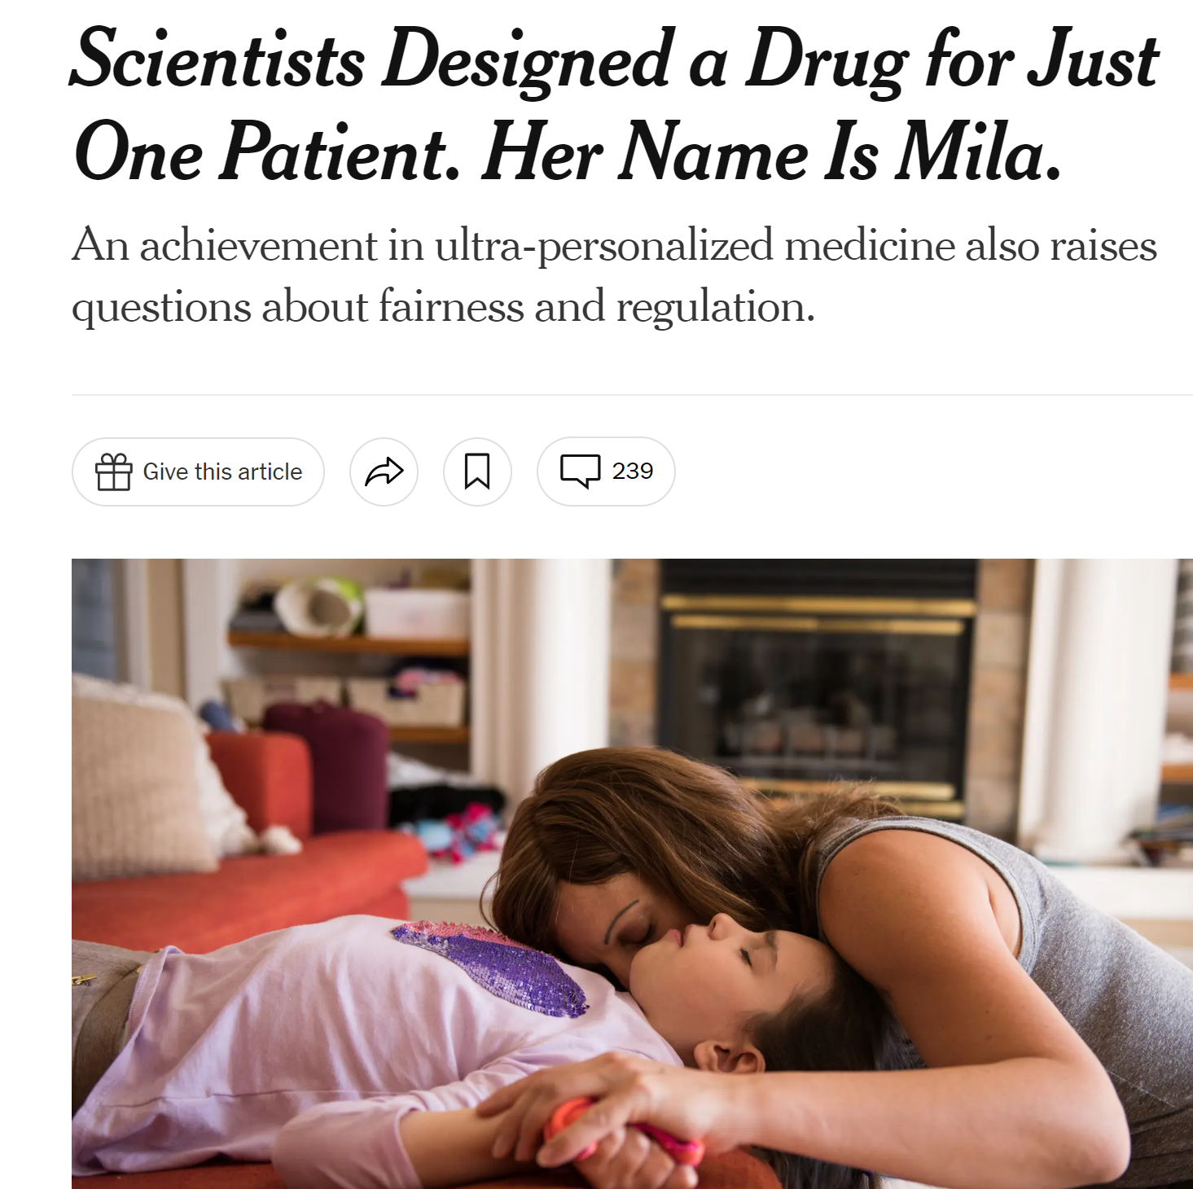
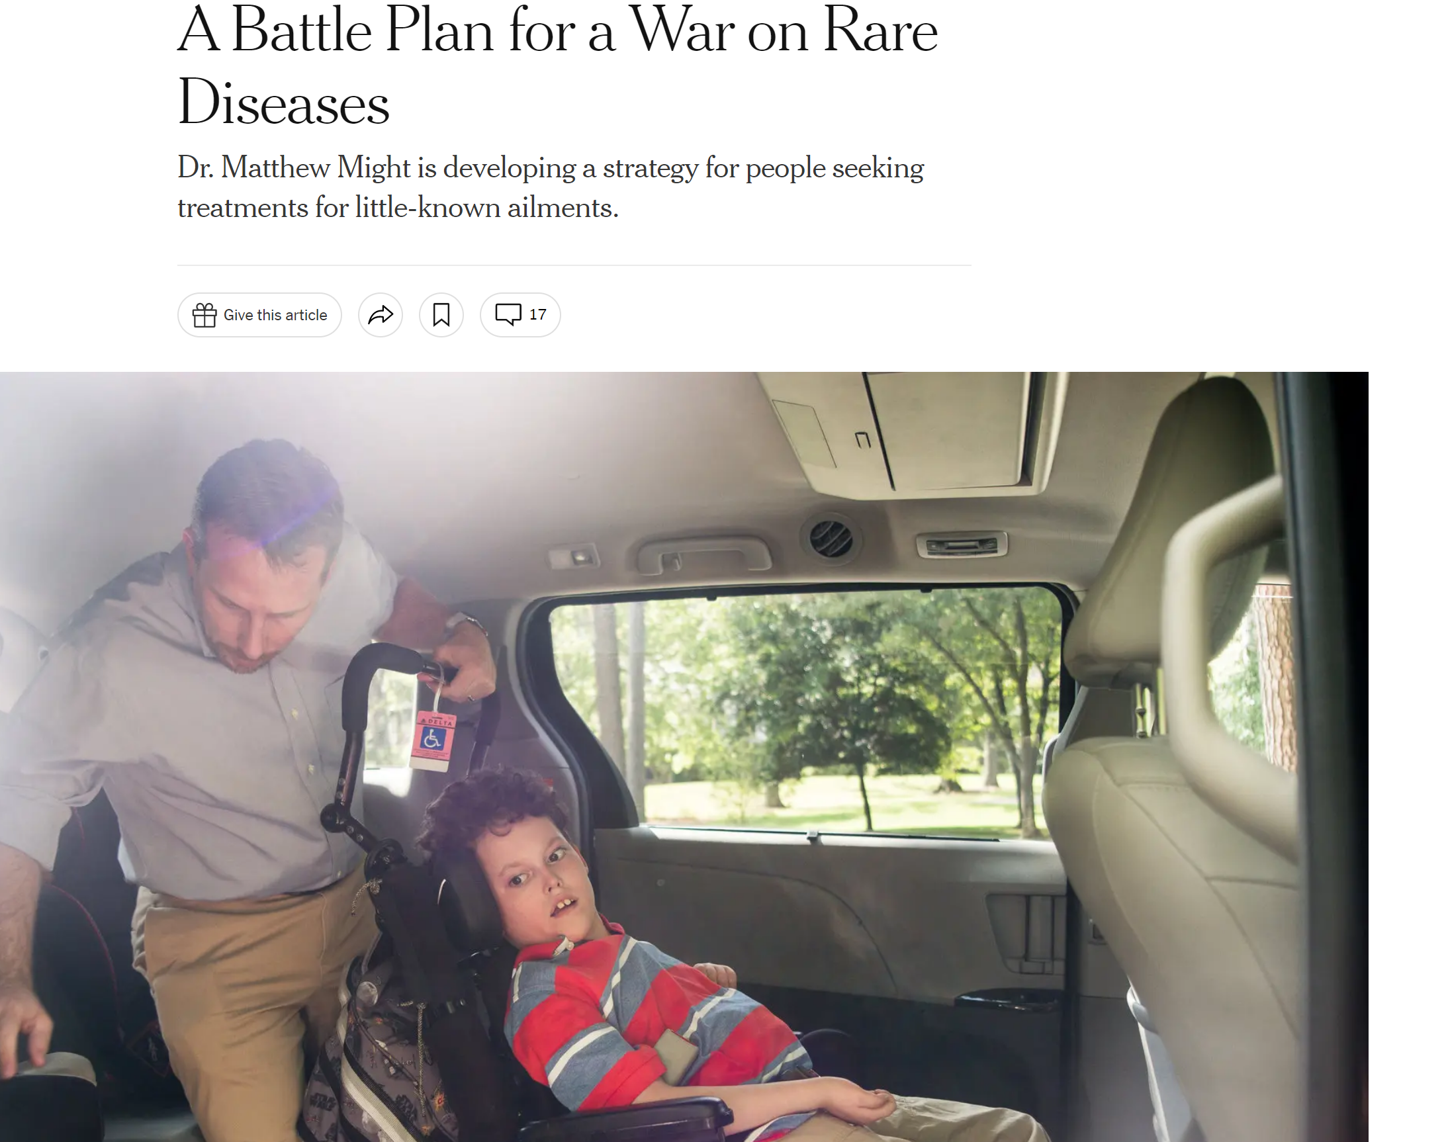
Notes:
Indeed, in the rare disease world patient engagement increasingly looks more like "patients engaging scientists" as opposed to the reverse.
To be clear, there are many benefits to this model, and the involvement in the research process is essential – there is so much science and scientists can learn from them, and much of what they call for in terms of changes to how research is done are legitimate critiques.
AT the same time, the families pushing for these therapies are also often those who will be able to access them, even at the extremely high costs, with no clear plan for how to expand access both within and outside the United States

Slide 46
Variation within patient communities
Notes:
We also see fundamental differences in perspectives within rare disease communities.
You may be aware of the controversy over the new therapy for dwarfism, which spurs growth but as of yet has not been shown to actually improve health outcomes.
Meanwhile disability advocates – and specifically the patients themselves – are frustrated by the funds spent to develop these types of drugs without consider to alternative ways to use this funding to identify effective interventions to improve health and quality of life.

Slide 47
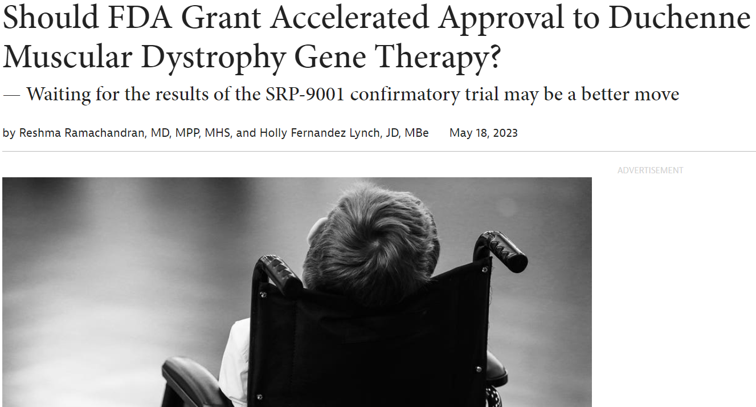
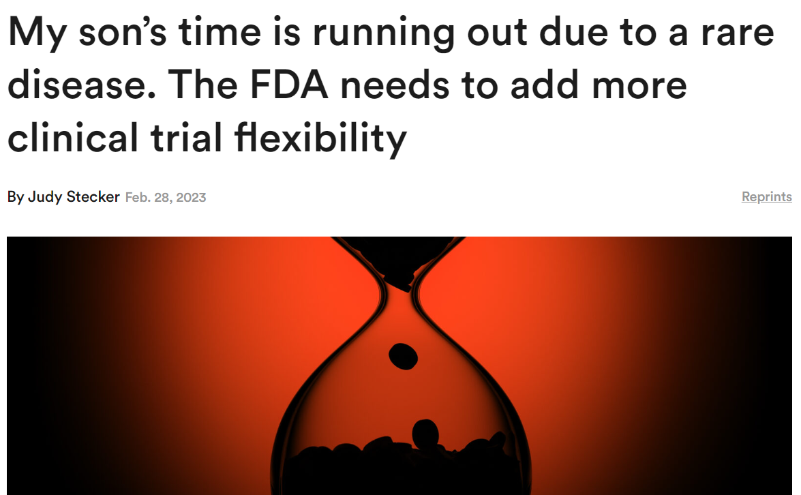
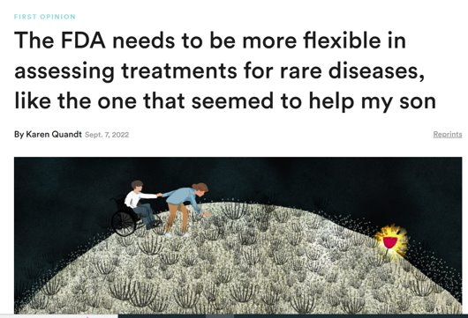
Notes:
This is also concerning when current patient organizations partner with private companies to lobby the FDA for accelerated approval with limited evidence of efficacy
While these efforts may provide the opportunity for current patients to try the drug,
it raises many hurdles to gathering confirmatory data,
running the risk of exposing future patients – who don’t have a voice in the conversation – to ineffective drugs for many years, and often at extraordinary costs.
Dr. Bateman-House has done some great work on this

Slide 48
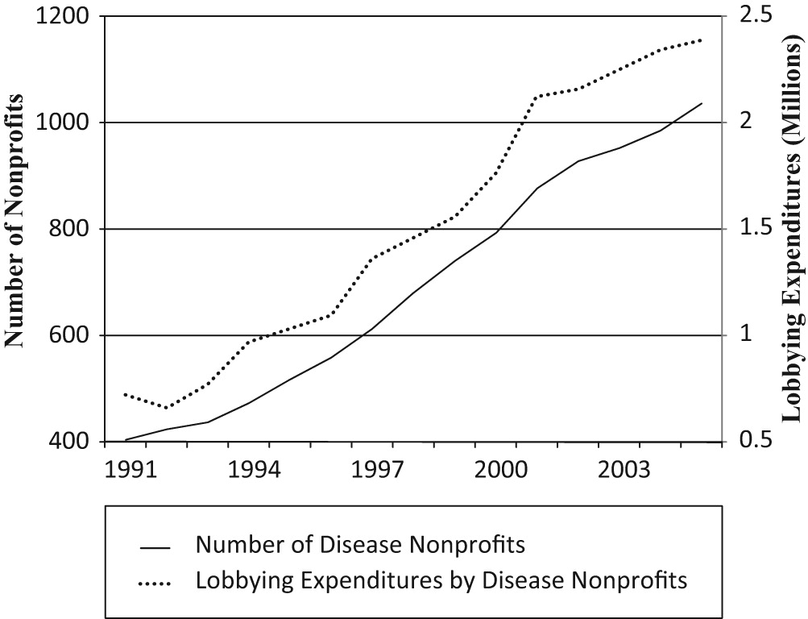
Whose voices drive resource allocation?
Best, Rachel Kahn. 2012. “Disease Politics and Medical Research Funding: Three Ways Advocacy Shapes Policy.” American Sociological Review 77 (5): 780–803.
Notes:
While this is at regulatory end of the process, the intersection of equity and engagementis also relevant all the way at the front end, when funding is decided.
Since the 1990s – explosive growth in Increase in disease-specific advocacy for research funding
And studies have found that this works – for each $1,000 spent on lobbying associated with a $25,000 increase in research funds the following year
However, in aggregate, studies have showed that disease specific advocacy has shifted money away from diseases that primarily affect women and blacks

Slide 49
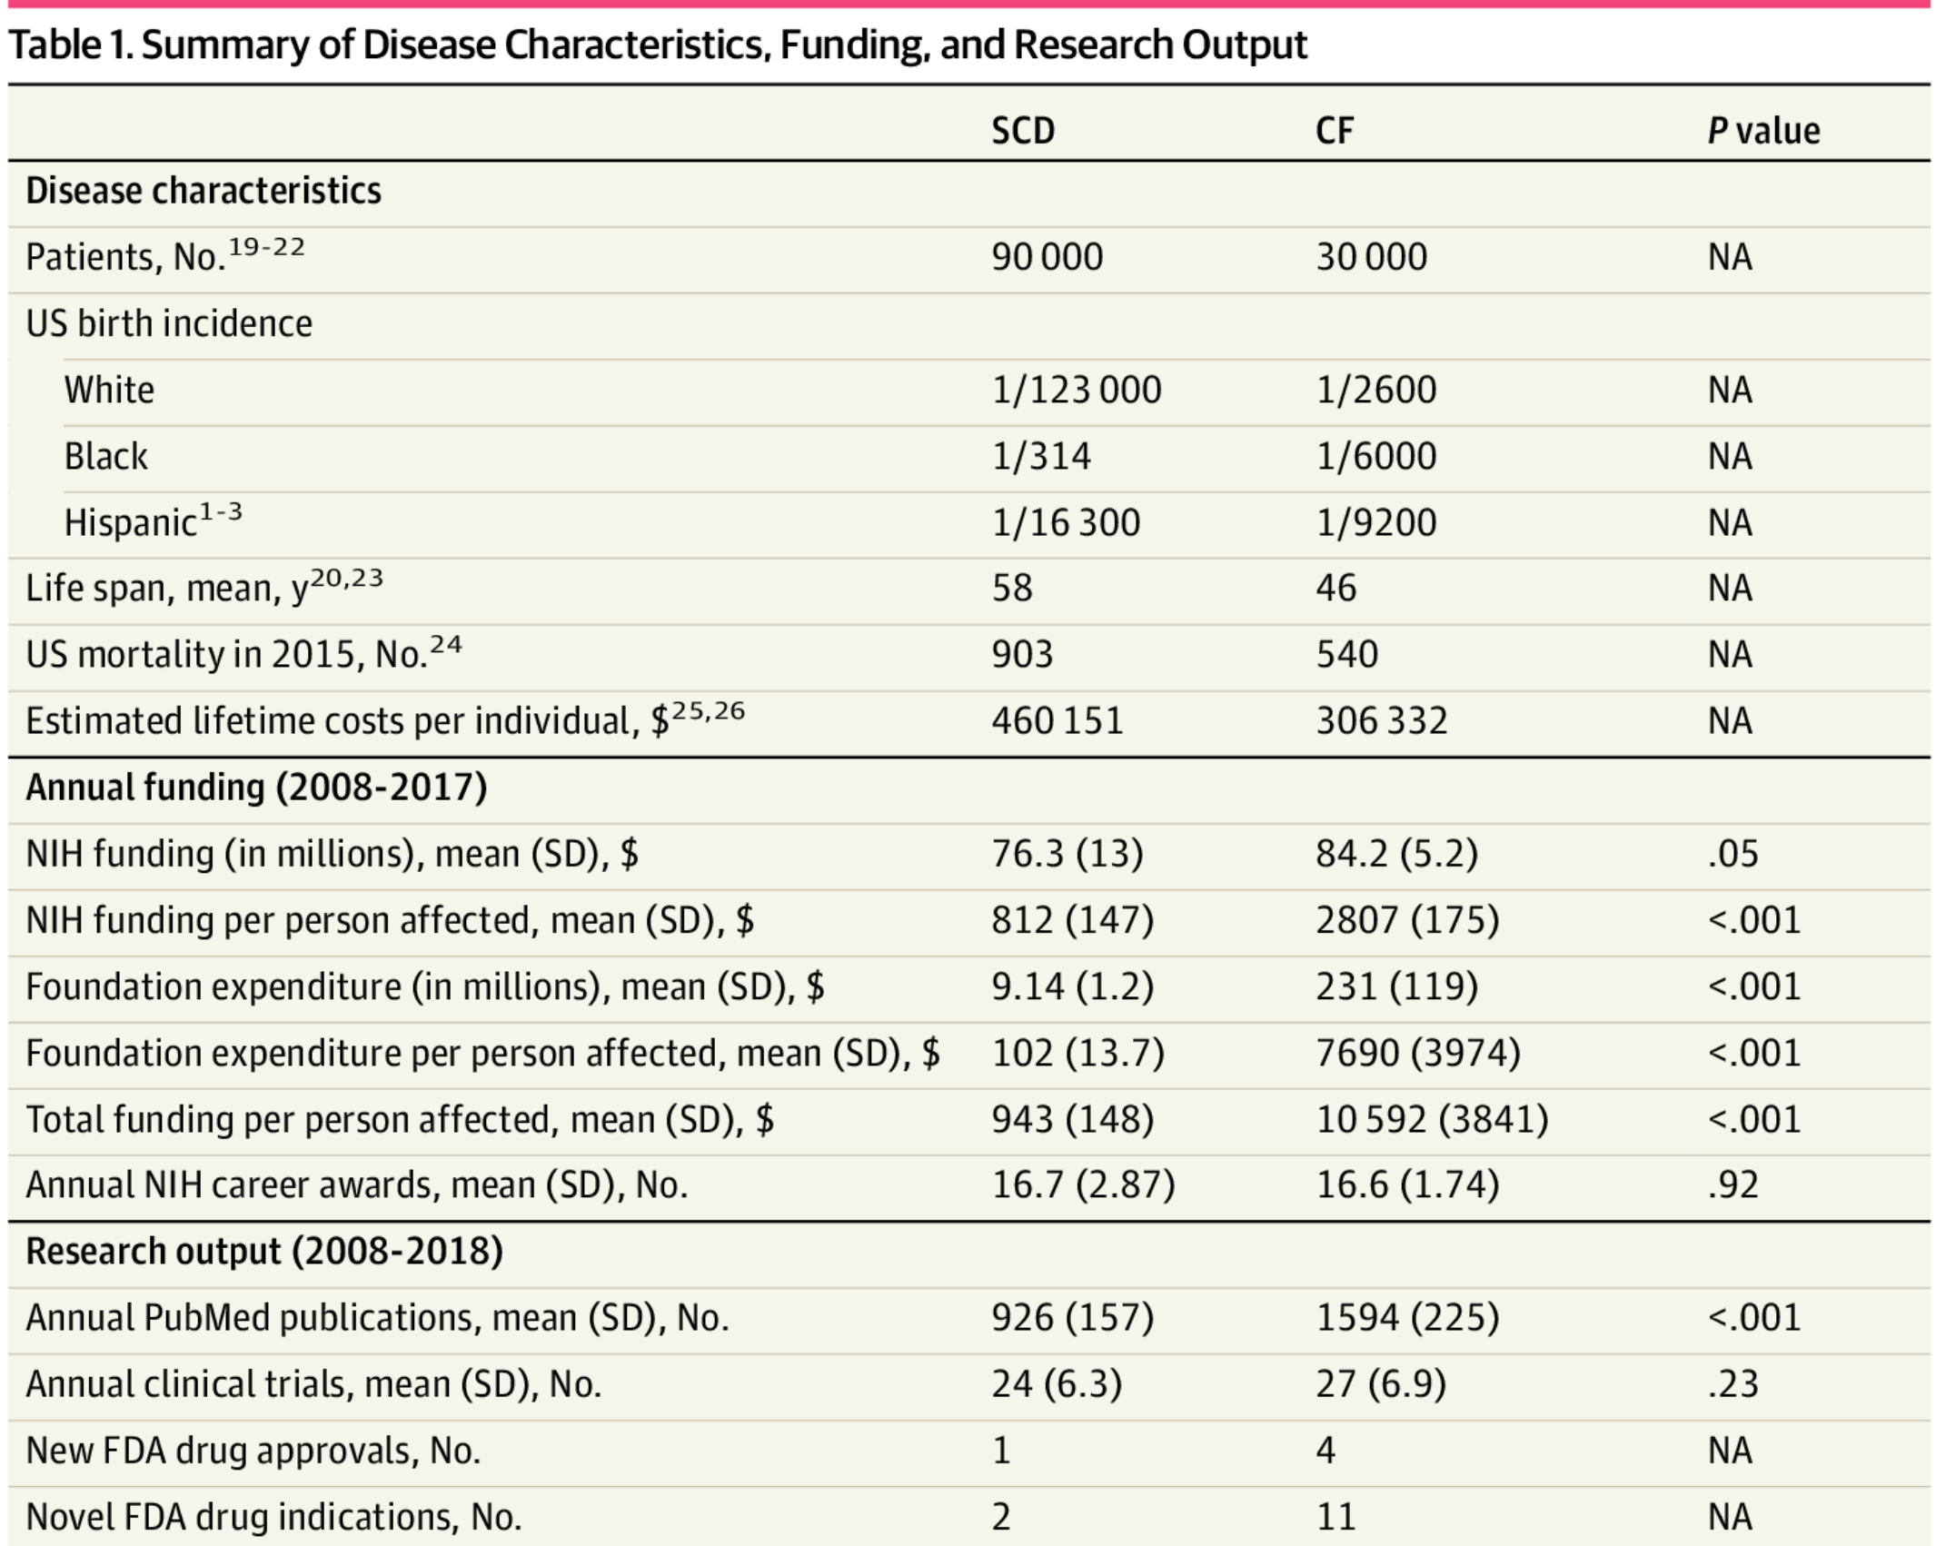
Cystic Fibrosis vs. Sickle Cell Disease
(Farooq et al. 2020)
Notes:
This is particularly concerning when diseases disproportionately affect groups already facing health disparities.
Indeed, a recent review of progress in two rare diseases – cystic fibrosis and sickle cell –
found dramatic and consistent differences in publications, therapeutic advances, public and particularly private funding, well over 7000 was spent per person affect with cF compared to only 102 for sickle cell.
While I am heartened by the anticipated approval of the first gene therapies for sickle cell, we have been underfunding research on this disease for decades.

Slide 50
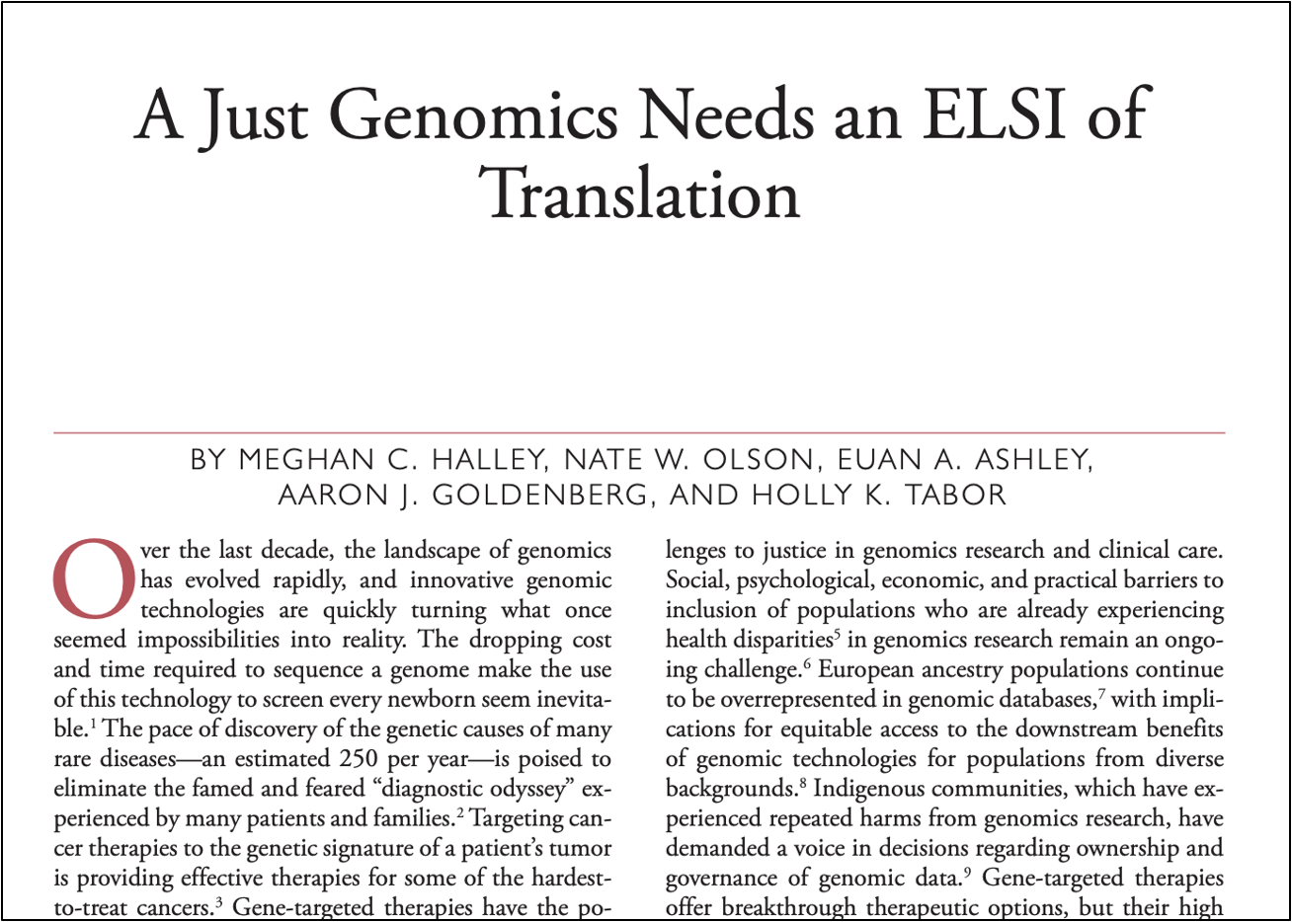
Integrating Equity Upstream in the Translational Pipeline
Augment Consent
Institutional trustworthiness
Ancillary care
Rebalance Beneficence
Expectations of benefit
Minimizing burdens
Implement Justice
Community engagement
Integrated approaches to rare disease research
Notes:
Is equity antithetical to innovation?
Against “Trickle down equity”
Build equity upstream in the R&D pipeline
Augment Consent: Trustworthiness and Relationships of Care
Promote autonomy while accounting for social, political and economic contexts in which research is conducted (improving consent process and create more opportunities to engage)
Promote a stronger focus on trustworthiness in researchers and research institutions
Expanding Beneficence: Understanding Patient/Community Perspectives on Benefits/Burdens
Increased recognition of the burdens often shouldered by underserved participants including travel and time, missed work, lost wages and costs of childcare, etc.
Promote a broader conception of benefits (including expanding notions of “utility of research participation” and supporting participants in navigating the healthcare system and accessing the care needs)
Implementing Justice: Engaging Communities in Defining a Just Genomics
Create more diverse cohorts, but avoid focusing only on recruitment and inclusion
Need more funding opportunities that focus on more than one condition at a time
Focus more heavily on engagement with the purpose of relationship building
Include more community based participatory approaches to avoid only a surface nod to “patient or community perspectives/voices”
More holistically incorporate community perspectives in the design and conduct of gene therapy research and other translational genomics activities.

Slide 51
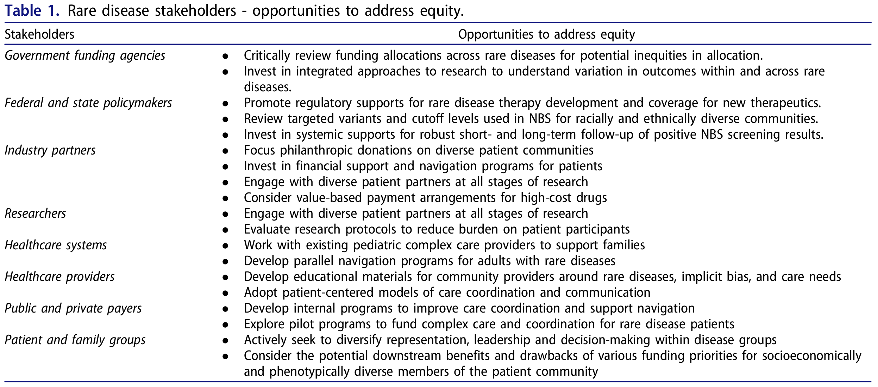
Integrating Equity Upstream in the Translational Pipeline
Notes:
Accomplishing such a transition is not the responsibility of a single stakeholder alone, but
A multitude of stakeholders

Slide 52
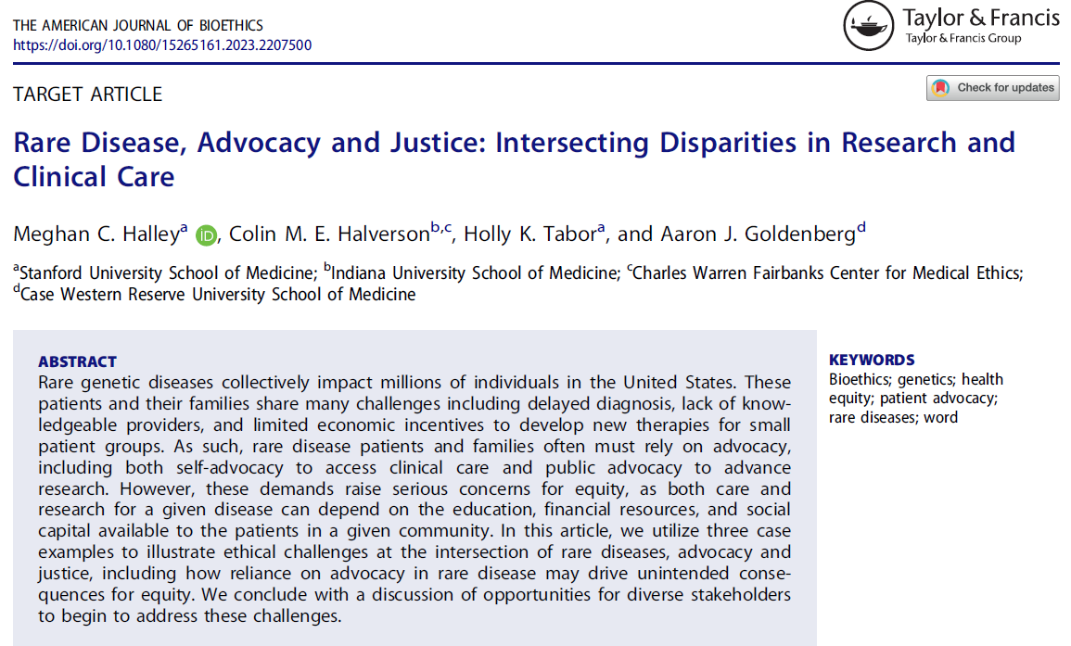
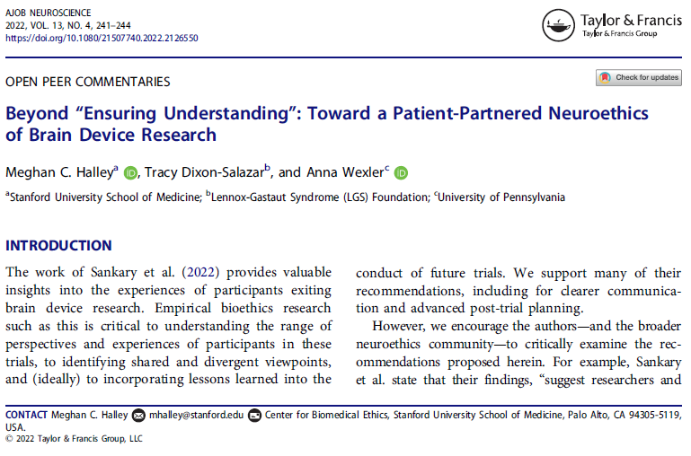
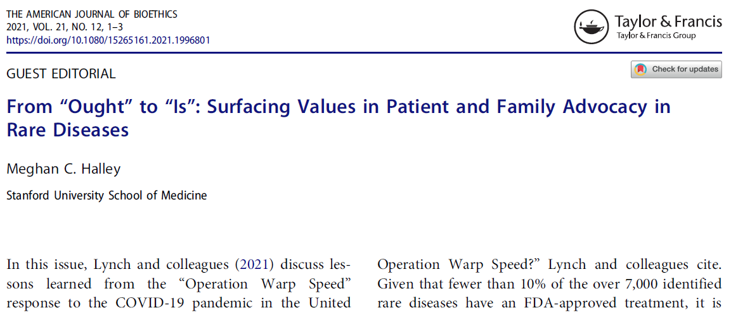
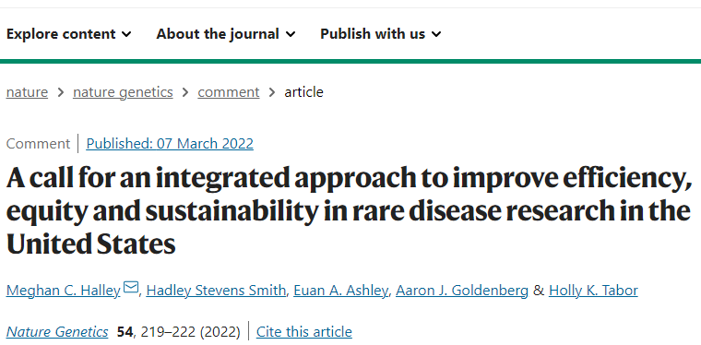
Notes:
My colleagues and I have written multiple commentaries on this topic that I would encourage you to read if you are interested,
Because on the one hand – having patient engaged in research has a range of empirical and ethical justifications
But we lack systematic, empirical data on how all of this is playing out in practice to guide the development of ethical principles moving forward.
Just funded R01 will be looking at these issues.

Slide 53
Thank you!
MENTORS, MENTEES AND COLLABORATORS
Mildred Cho, PhD, Stanford University
Holly Tabor, PhD, Stanford University
David Magnus, PhD, Stanford University
Euan Ashley, MD, PhD Stanford University
Doug Owens, PhD, Stanford University
Miriam Kupperman, PhD, UCSF
Hadley Stevens Smith, PhD, Harvard University
Jennifer Young, PhD, Northwestern University
Kevin Mintz, PhD, Stanford University
Eiiana Ward-Lev, BS, Stanford University
Emily Miller, BA, UCSD
Charis Tang, BA, Stanford University
AudreyStephannie Maghiro, BS, WUSL
Cara Hunt, MA, NYU Langone
Faculty and staff at the Stanford Center for Undiagnosed Diseases
Members of the Value Ethics Working Group
FUNDING
NHGRI R01HG014059 (PI: Halley)
NHGRI K01HG011341 (PI: Halley)
Stanford MCHRI UDN Seed Grant (PI: Tabor)
NHGRI U01HG010218 (PI: Ashley)
NIH U2CNS132415 (PI: Kohane)
To the patients and families living with undiagnosed and rare diseases – Thank you for letting me share your stories.

Slide 54
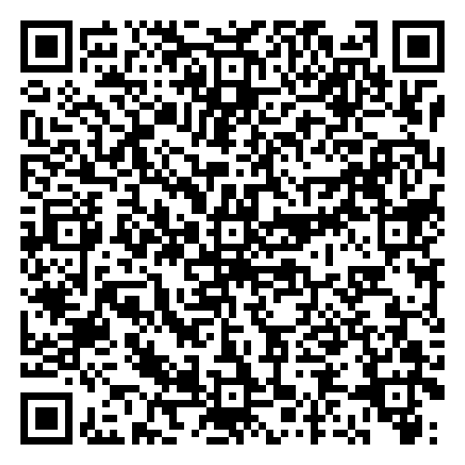
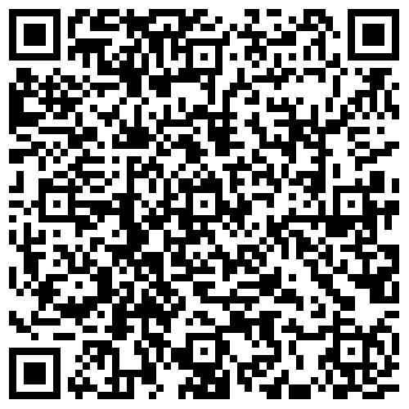
References Cited
Feedback Welcome!

