Slide 1
What About Justice?
Lauren D. Nephew MD, MA, MSCE
Assistant Professor of Medicine, Division of Gastroenterology & Hepatology
Associate Vice Chair of Health Equity, Department of Medicine
Associate Member, Simon Comprehensive Cancer Center

Slide 2
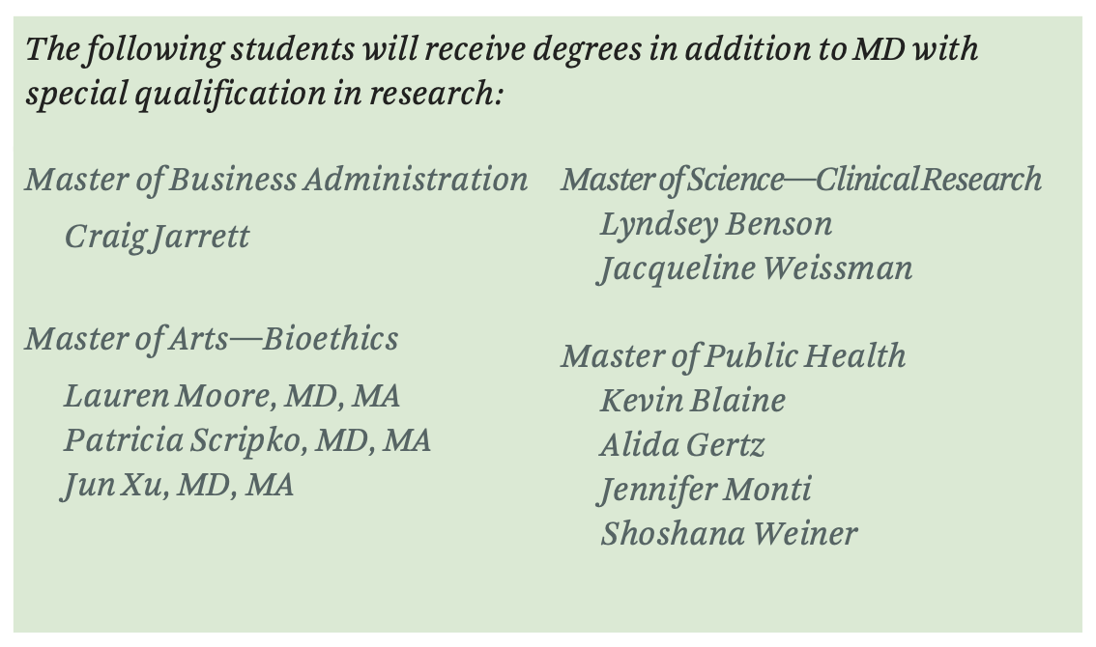
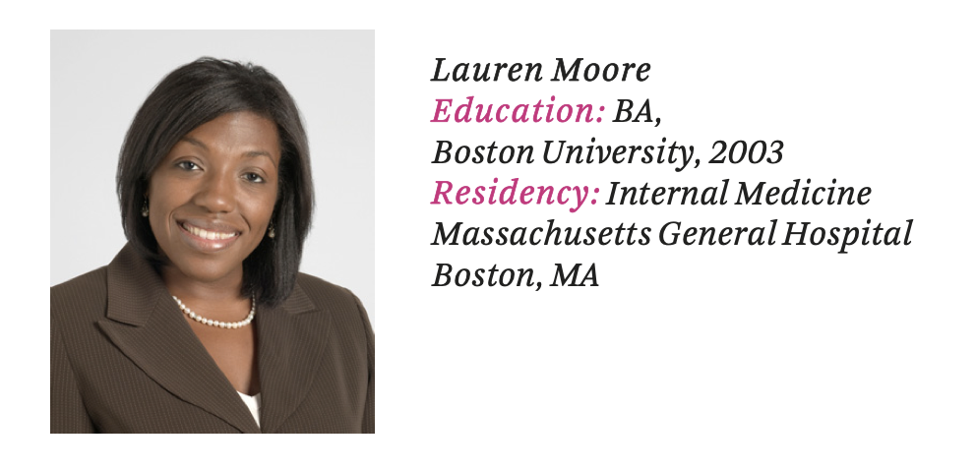

Slide 3
Ethical Constructs in Transplantation
🔹 Scarce Resource Allocation – The ethical framework guiding how limited resources (e.g., organs) are distributed fairly and effectively.
🔹 Distributive Justice – The principle that ensures benefits and burdens in healthcare are allocated fairly among all individuals.
🔹 Autonomy – The right of patients to make informed decisions about their care, including the decision to accept or refuse a transplant.
🔹 Beneficence – The duty of healthcare providers to act in the best interest of patients.
🔹 Non-Maleficence – The obligation to avoid causing harm, balancing risks and benefits in medical decision-making.
🔹 Moral Distress – The emotional and ethical discomfort that arises when clinicians recognize an injustice but feel powerless to change it.
Notes:
Even after learning these ethical constructs, I kept asking myself—what about justice? Where was the structural accountability to ensure fair access to transplantation? Ethical principles guided decisions, but justice felt like an afterthought."

Slide 4
Of the four major ethical principles in transplant—autonomy, beneficence, non-maleficence, and justice—why does justice receive the least attention?
What would it look like if justice were treated as an equal ethical principle in transplantation?
Notes:
Today, I want to challenge how we think about justice in liver transplantation. I’ll show you how the principles of autonomy, beneficence, and non-maleficence are structurally embedded in transplant care—but justice is often an afterthough

Slide 5
Objectives
✔️ Examine Ethical Principles in Healthcare & Transplantation – Identify which principles are embedded in current practice and how justice is overlooked.
✔️ Review Disparities in Liver Transplantation – Highlight key inequities in access and outcomes.
✔️ Public Perception of Injustice & Consequences– Highlight relationship between trust, justice and organ donation.
✔️ Reimagine a Just Transplant System – Explore how justice can be integrated into transplant policies.

Slide 6
Examine Ethical Principles in Healthcare & Transplantation

Slide 7
Autonomy
🔹 Patients have the right to make their own medical decisions.
🔹 This is codified in informed consent and shared decision-making.
🔹 Informed consent laws ensure patients can accept or refuse treatment.
🔹 Transplant patients must actively consent to listing and organ offers.
Notes:
Autonomy is legally protected—patients have the right to make their own medical decisions.
This principle is reinforced through informed consent laws and shared decision-making frameworks, ensuring that providers cannot force treatment on patients.
Informed consent is not just ethical—it is legally mandated.
Laws require that before any medical procedure, patients must be given clear, understandable information about risks, benefits, and alternatives.
Violating informed consent laws can result in legal liability, institutional penalties, and even loss of medical licensure.
Transplantation requires more than passive consent—patients must actively opt-in at multiple stages.
Legal and regulatory frameworks ensure:
Patients cannot be listed for transplant without explicit consent.
Patients must confirm acceptance of an organ offer, often under time-sensitive conditions.
Informed consent is an example of an ethical principle that has been codified into law and actively enforced.
Regulations ensure accountability, and violations carry real consequences for institutions and providers.

Slide 8
Non-Maleficence
🔹 Non-maleficence is embedded in patient safety policies to prevent harm.
🔹 Institutions implement safeguards such as infection control, medication safety checks, and surgical protocols.
🔹 The MELD scoring system ensures the sickest patients receive transplants first, minimizing harm from delays.
.
Notes:
Non-Maleficence: The Duty to Do No Harm
Non-maleficence is a core ethical principle in medicine and is actively reinforced through patient safety measures.
Institutions must implement safeguards to prevent harm to patients, including:
Infection control protocols to minimize hospital-acquired infections.
Medication safety systems, such as barcode scanning, to prevent errors.
Surgical checklists and timeouts to reduce procedural mistakes.
Failure to uphold these safeguards can result in lawsuits, regulatory action, and loss of accreditation.
The MELD Score: A System Designed to Minimize Harm
In transplantation, delayed access to care can be fatal—which is why the MELD scoring system prioritizes the sickest patients.
MELD-based allocation is designed to reduce harm by ensuring that organs go to those most at risk of dying without a transplant.
Non-maleficence is actively upheld through laws, policies, and medical standards.
Patient safety is a regulatory requirement—hospitals must comply with safety protocols or face consequences.

Slide 9
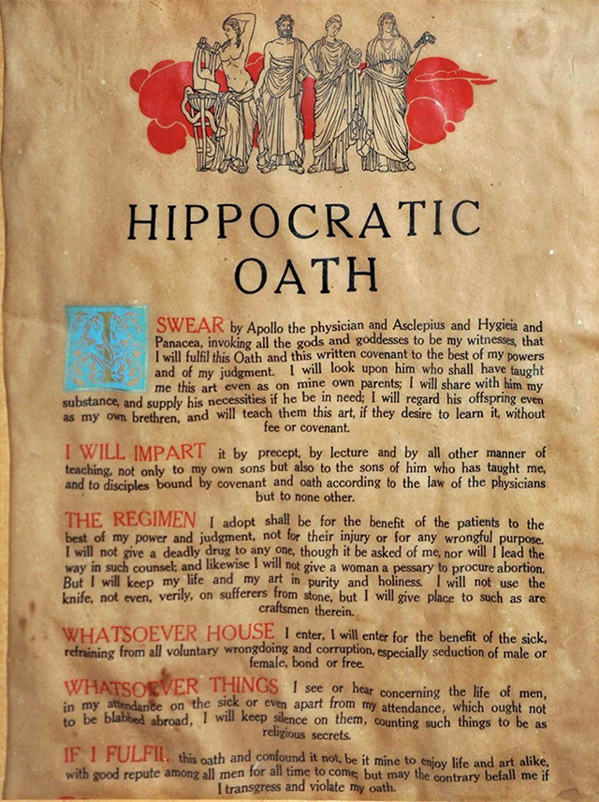
Beneficence
🔹 The obligation to act in the patient’s best interest is embedded in medical training and guidelines.
🔹 Evidence-based treatment protocols guide the management of chronic diseases, infections, and cancer.
🔹 In transplant, listing criteria ensure that transplantation optimizes survival.
Notes:
Beneficence is the ethical principle that requires healthcare providers to act in the patient’s best interest.
Medical education and professional standards are built around the principle of beneficence.
Physicians take the Hippocratic Oath, which explicitly emphasizes acting in the best interest of the patient.
Evidence-Based Medicine is a Legal Mandate
Chronic diseases, infections, and cancer must be treated according to evidence-based guidelines.
Failing to follow standard-of-care treatments can result in medical malpractice claims and loss of licensure.
Regulatory bodies like the FDA and Joint Commission enforce standards to ensure that patients receive the best available care.
Beneficence in Transplantation: Optimizing Survival
UNOS and transplant center policies ensure that listing criteria prioritize survival benefit and protect recipients.
Patients must meet objective criteria (e.g., MELD score, medical stability) to qualify for transplantation.
Like autonomy, beneficence is backed by laws, regulations, and medical enforcement.
Transplant policies are designed to optimize survival—but they do not systematically ensure equity..

Slide 10
What About Justice?

Slide 11
Justice
🔹 Where Is the Structural Implementation?
🔹 Some modern medical oaths explicitly reference justice and equity.
The Declaration of Geneva (1948, revised 2017): "I will not permit considerations of age, disease, disability, creed, ethnic origin, gender, nationality, political affiliation, race, sexual orientation, social standing, or any other factor to intervene between my duty and my patient."
The Modern Hippocratic Oath (Lasagna Version, 1964): "I will remember that I remain a member of society, with special obligations to all my fellow human beings, those sound of mind and body as well as the infirm.”
🔹 Unlike autonomy, beneficence, and non-maleficence, justice is often debated rather than embedded in practice.
🔹 No systemic safeguards exist to guarantee equitable access to liver transplantation.
Notes:
Justice is the principle of fair and equitable treatment in healthcare.
Unlike autonomy, beneficence, and non-maleficence, which are codified into law and policy, justice is often aspirational rather than enforceable.
Modern Medical Oaths Include Justice—But That’s Not Enough
The Declaration of Geneva (2017 revision) explicitly rejects discrimination in patient care, stating that factors like race, socioeconomic status, and disability should not affect treatment decisions.
The Modern Hippocratic Oath (Lasagna Version, 1964) recognizes physicians' responsibility to society, not just individual patients.
These explicit commitments to equity show how the ethical framework has evolved—but they do not ensure structural enforcement.
Unlike the first three ethical principles, justice remains a point of debate rather than a universal requirement.
In autonomy, patients must legally consent to treatment.
In beneficence, physicians must follow evidence-based guidelines and act in the patient's best interest.
In non-maleficence, institutions must implement safety policies to prevent harm.
But where is the required, enforceable policy ensuring justice in access to care?
Transplantation: Justice Remains an Afterthought
No federal law guarantees equitable access to liver transplantation.
The MELD system prioritizes medical urgency but does not account for structural inequities (e.g., late referrals, financial barriers, social determinants of health).
Other ethical principles are embedded in regulations—justice is left to individual programs and subjective decisions.

Slide 12
Without Justice There is Inequality

Slide 13
Review Disparities in Liver Transplantation

Slide 14
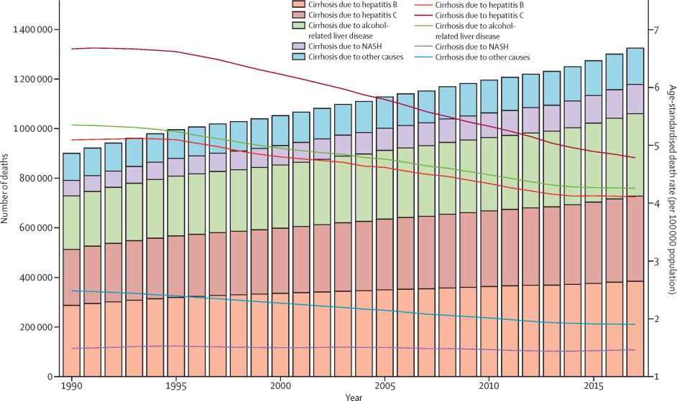
Burden of Cirrhosis
Globally the prevalence of cirrhosis increased from:
110.6 per 100,000 population in 1990
132.5 per 100,000 population in 2017
The global, regional, and national burden of cirrhosis by cause in 195 countries and ter-ritories, 1990-2017: a systematic analysis for the Global Burden of Disease Study 2017. Lancet Gastroenterol Hepatol 2020; 5:245–266.
Kaplan A, Fortune B, Ufere N, Brown RS Jr, Rosenblatt R. National Trends in Location of Death in Patients With End-Stage Liver Disease. Liver Transpl. 2021 Feb;27(2):165-176.
Notes:
Cirrhosis is on the rise all round the world.
The figure on the right has color coded 5 major etiologies of cirrhosis and you can see they all have increased over the past 20 years.
Specifically,
The burden per 100,000 was 110.6 in 1990 and 132.5 in 2017

Slide 15
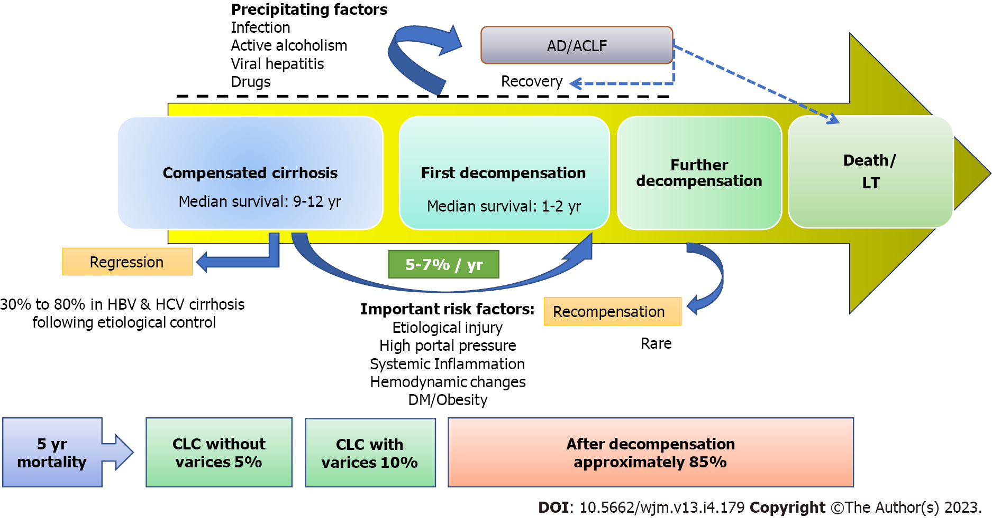
High Mortality from ESLD
Kumar R, Kumar S, Prakash SS. Compensated liver cirrhosis: Natural course and disease-modifying strategies. World J Methodol. 2023 Sep 20;13(4):179-193. doi: 10.5662/wjm.v13.i4.179. PMID: 37771878; PMCID: PMC10523240.
Notes:
The natural progression of cirrhosis is characterized by a continuum from an asymptomatic compensated phase to a symptomatic decompensation phase.
The rate of transition from a compensated to a decompensated stage is about 5%-7% each year.
The 5-year mortality rate in compensated cirrhosis without or with varices is 5% and 10%, respectively. T
After decompensation that mortality is 85% here are several known factors associated with decompensation
CLC: Compensated liver cirrhosis; DM: Diabetes mellitus; HBV: Hepatitis B virus; HCV: Hepatitis C virus; LT: Liver transplantation.

Slide 16
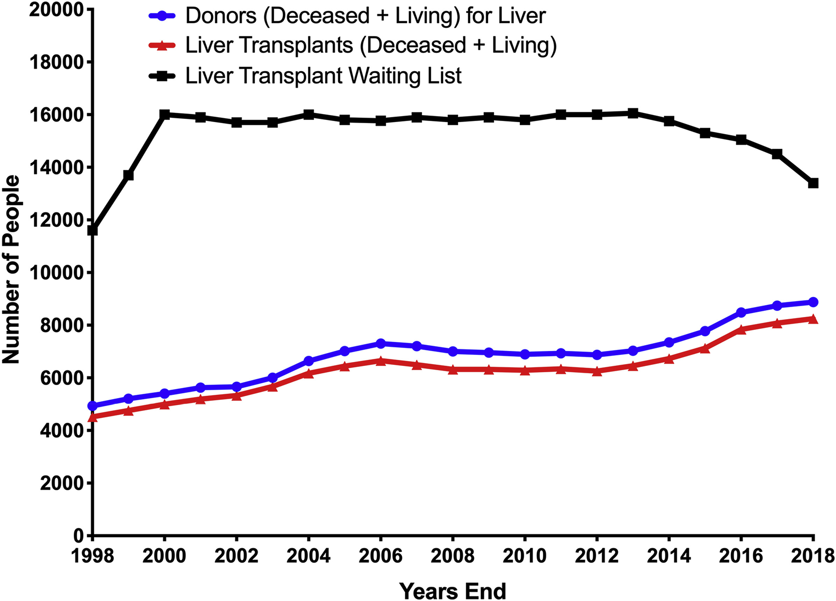
More LT but Large Waitlist
Goldaracena N, Cullen JM, Kim DS, Ekser B, Halazun KJ. Expanding the donor pool for liver transplantation with marginal donors. Int J Surg. 2020 Oct;82S:30-35.
Notes:
LT is the only cure to solve that problem. There have been steady increases in the number of transplants and donors but numbers on waitlist remain high.

Slide 17
DISPARITIES IN ACCESS TO LT
National Research Council 2022. Realizing the Promise of Equity in the Organ Transplantation System. Washington, DC: The National Academies Press. https://doi.org/10.17226/26364.

Slide 18
Gender Disparities Along the LT Care Cascade
Pre-Evaluation
Evaluation
In a Michigan cohort the % of women not listed due to active substance use was higher than in men(42% versus 35%)
Post-OLT
Lower quality of life scores in women:
Women less likely to move from diagnosis to evaluation for LT in multicenter Pennsylvania cohort (p<0.001)
Waitlist/Allocation
Women have 15-30% higher waitlist mortality than men
20-30% less likely to undergo LT
Psychosocial adjustment
Physical distress
Personal function
Bryce CL, Angus DC, Arnold RM, et al. Sociodemographic differences in early access to liver transplantation services. Am J Transplant. 2009;9:2092-101
McElroy LM, Likhitsup A, Scott Winder G, Saeed N, Hassan A, Sonnenday CJ, Fontana RJ, Mellinger J. Gender Disparities in Patients With Alcoholic Liver Disease Evaluated for Liver Transplantation. Transplantation. 2020 Feb;104(2):293-298.
Nephew LD, Serper M. Racial, Gender, and Socioeconomic Disparities in Liver Transplantation. Liver Transpl. 2021 Jun;27(6):900-912
Sarkar M, Watt KD, Terrault N, Berenguer M. Outcomes in liver transplantation: does sex matter? J Hepatol. 2015 Apr;62(4):946-55
Notes:
Women were also less likely to undergo LT in that cohort

Slide 19
Timeline for Disparities in LT for Women
Assuming equity the death of 800 women could have been prevented
Verna EC, Lai JC. Time for Action to Address the Persistent Sex-Based Disparity in Liver Transplant Access. JAMA Surg. 2020;155(7):545–547. doi:10.1001/jamasurg.2020.1126

Slide 20
Racial and SES Disparities Along the LT Care Cascade at IU
3,500 patients referred to IU for LT evaluation between 2011-2018
Referred for LT
Death During Eval
Waitlisting
6% Black
39% Women
12.5% Rural
41% Medicaid
Neighborhood Poverty
sHR 1.49
Cl 1.09-2.09
Neighborhood Poverty
aOR 0.56
Cl 0.38-0.82
Mohamed, KA, Ghabril, M, Desai, A, Orman, E, Patidar, KR, Holden, Nephew, LD. Neighborhood poverty is associated with failure to be waitlisted and death during liver transplantation evaluation. Liver Transpl. 2022; 28: 1441– 1453
Notes:
In addition to having little data about the completion rate of each step. We know very little about which patients are having the hardest time.
When we looked at our data of who is even referred for LT. Mind you we are that we are the only LT center in the state. Only 6% of the referral population was Black, despite The Black population of IN is 11-12%
When we look at those who were waitlisted, you were less likely to be waitlisted if you lived in the highest poverty areas, you were not “Other race”.

Slide 21
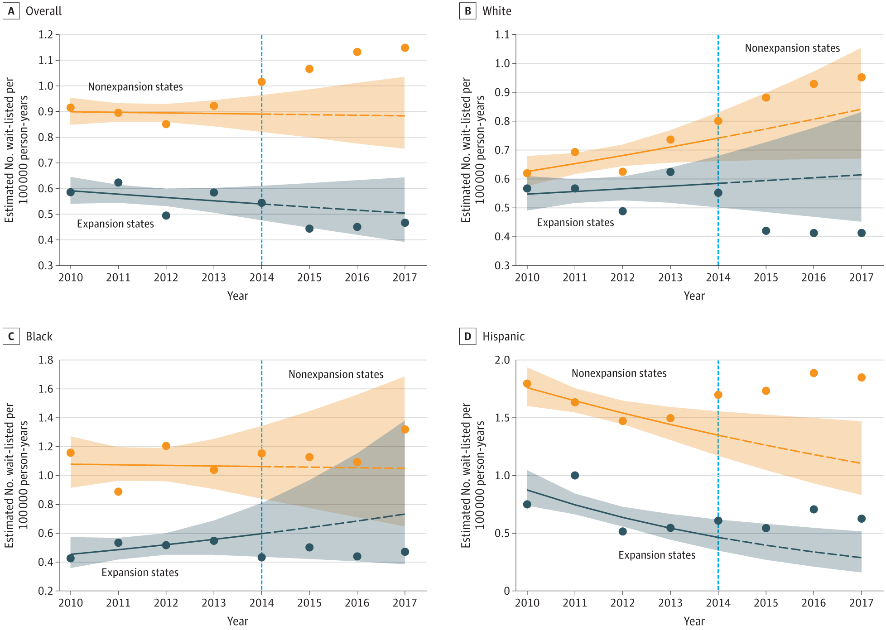
Association of State Medicaid Expansion With Racial/Ethnic Disparities in Liver Transplant Wait-listing in the United States
Overall
White
Black
Hispanic
Nephew LD, Mosesso K, Desai A, et al. Association of State Medicaid Expansion With Racial/Ethnic Disparities in Liver Transplant Wait-listing in the United States. JAMA Netw Open. 2020;3(10):e2019869.

Slide 22
Area-level income associated with LT even with access to universal health care
Flemming, Jennifer A.; Muaddi, Hala; Djerboua, Maja; Neves, Paula; Sapisochin, Gonzalo; Selzner, Nazia*. Association between social determinants of health and rates of liver transplantation in individuals with cirrhosis. Hepatology 76(4):p 1079-1089, October 2022
Notes:
First, in a universally insured health care system, rates of LT are similar for those residing in neighborhoods with the highest proportions of immigrants and racial minorities compared to the least diverse neighborhoods. However, our data also demonstrate that those individuals living in the lowest‐income and most vulnerable neighborhoods for housing instability and material resources had a >40% lower rate of transplant after accounting for important confounders. These results suggest that although universal access to health care can help mitigate racial/ethnic disparities, other SDOH related to income and housing continue to perpetuate inequality in access to LT.

Slide 23
Public Perception of Injustice & Consequences

Slide 24
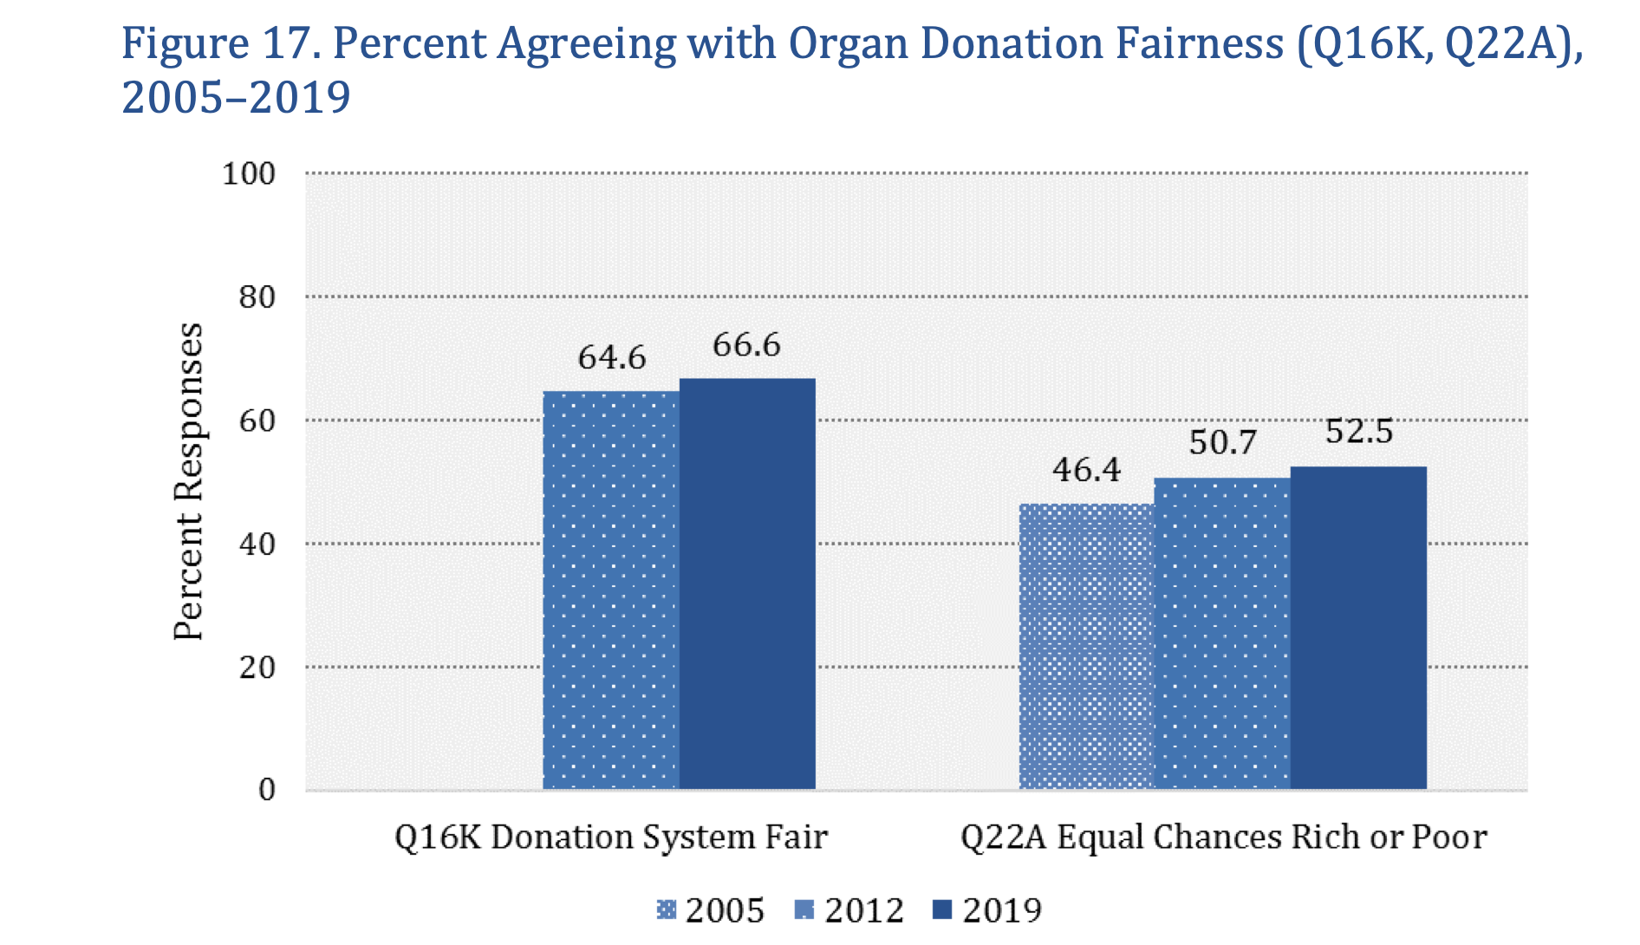
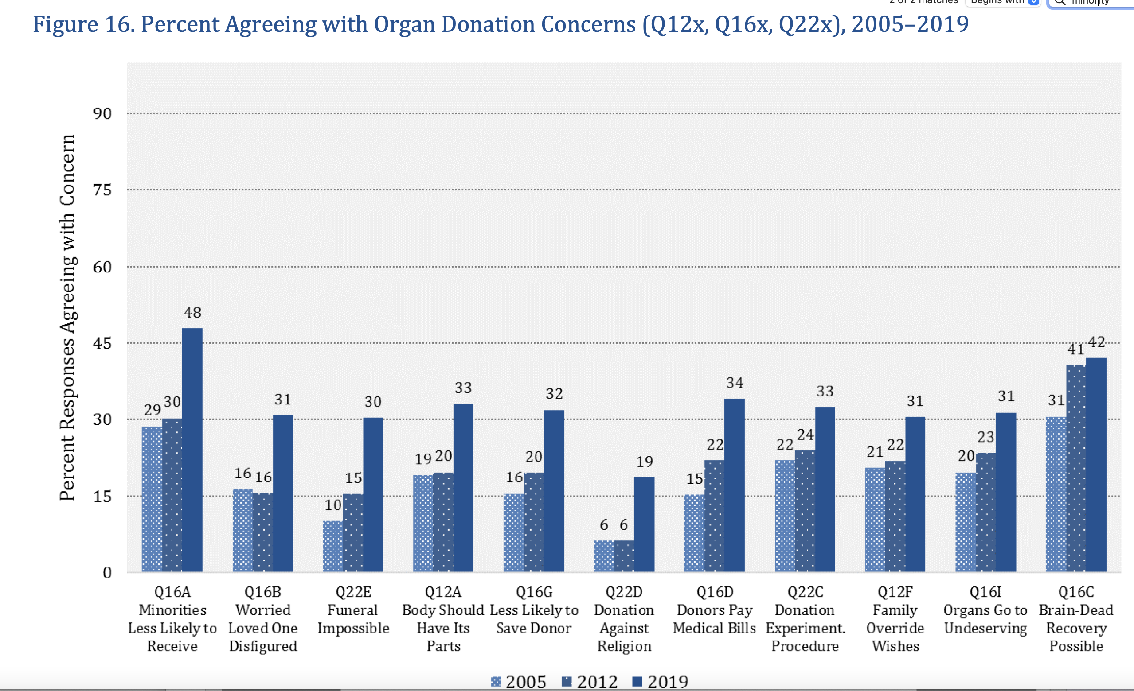
The Public Doesn’t Trust Us to be Just
The 2019 National Survey of Organ Donation Attitudes and Practices
https://www.organdonor.gov/sites/default/files/organ-donor/professional/grants-research/nsodap-organ-donation-survey-2019.pdf

Slide 25
Why Is Trust Important in Organ Allocation?
“The values of altruism and autonomy—the foundations of organ procurement—rest on the presumption that organs, which are given freely, voluntarily and altruistically, will be distributed in a fair and impartial manner to those in need. Any policies, practices, or activities that suggest otherwise imperil the entire enterprise of voluntary and altruistic organ donation---Arthur Kaplan.”
When public trust declines, so too do deceased donation rates (Boulware et al., 2007; Wachterman et al., 2015).
http://perspectivesinmedicine.cshlp.org/content/4/3/a015685.full

Slide 26
Justice Trust Cycle
Justice strengthens trust
Trust increases participation
Participation reinforces justice
When justice is embedded into policies and practices, it builds public trust. People trust a system they perceive to be fair, transparent, and equitable.
Breaking this cycle (through inequitable policies or exclusionary practices) leads to distrust, disengagement, and widening disparities.
Notes:
Justice in healthcare means fairness in treatment, resource allocation, and decision-making.
When justice is embedded in policies and practices, it builds public trust in the system.
People trust systems that they perceive as fair, transparent, and equitable.
2️⃣ When Justice is Absent, Trust Erodes
Perceived injustice fuels mistrust.
If patients believe the transplant system is biased, they may opt out of organ donation or distrust medical recommendations.
Communities with historical medical injustices (e.g., racial disparities in transplantation) are less likely to trust healthcare institutions.

Slide 27
Perceived Inequity Predicts Likelihood to Donate
Nephew et al. Under Review

Slide 28
Medical distrust associated with intention to donate
Written and verbal donation intentions regressed on distrust in the healthcare system (N = 585)
 | β | P value | OR
Written donation intentions regressed on
Medical distrust | 0.04 | 0.12 | 1.04
Education level | 0.20 | 0.08 | 1.23
Verbal donation intentions regressed on
Medical distrust | 0.07 | 0.02 | 1.08
Education level | 0.35 | 0.01 | 1.42
Health insurance | −0.62 | 0.03 | 0.54
CHA group | 0.01 | 0.49 | 1.01
Marital status | 0.03 | 0.82 | 1.03
Russell E, Robinson DH, Thompson NJ, Perryman JP, Arriola KR. Distrust in the healthcare system and organ donation intentions among African Americans. J Community Health. 2012 Feb;37(1):40-7. doi: 10.1007/s10900-011-9413-3. PMID: 21626439; PMCID: PMC3489022.

Slide 29
Reimagine a Just Transplant System

Slide 30
Pragmatic WishlistIN LT
Early social needs and health literacy screening
National transplant equity metrics
Access to transplant care pathways
National Research Council 2022. Realizing the Promise of Equity in the Organ Transplantation System. Washington, DC: The National Academies Press. https://doi.org/10.17226/26364.

Slide 31
National Transplant Equity Metrics
🔹 Thoughtful regulation fosters accountability, resource allocation, and data-driven approaches.
🔹 Poorly designed regulation can incentivize gaming and harm under-resourced centers.
🔹 Examples of Regulation-Driven Innovation in Medicine:
Hospital Readmissions Reduction Program (HRRP)
Meaningful Use Program
Quality Metrics in Dialysis Care
Notes:
Regulation as a Driver of Innovation
Hope alone won’t eliminate disparities—regulation creates accountability.
Well-designed policies force institutions to innovate, adapt, and improve outcomes.
Benefits of Thoughtful Regulation
Holds healthcare systems accountable for quality and equity.
Encourages investment in infrastructure and process improvement.
Facilitates data-driven solutions by requiring reporting and transparency.
Risks of Poorly Designed Regulation
Incentivizes "gaming the system" rather than meaningful improvement.
Can disproportionately harm under-resourced centers, widening disparities instead of reducing them.
Examples of Regulation-Driven Innovation
HRRP (Hospital Readmissions Reduction Program)
Reduced avoidable readmissions by linking payments to performance.
Meaningful Use Program
Accelerated adoption of electronic health records (EHRs), improving data tracking and patient outcomes.
Quality Metrics in Dialysis Care
Led to better patient outcomes and more transparency in kidney disease management.
Regulation isn’t the enemy—it’s necessary to drive real change.

Slide 32
National Quality Metric Example
✔️ Catchment Area Mismatch: Does a transplant center’s waitlist reflect the demographics of the population it serves?
Define service area
Conduct a needs assessment
Outline a 5-year strategic plan to close gap by 10%
Incentivized

Slide 33
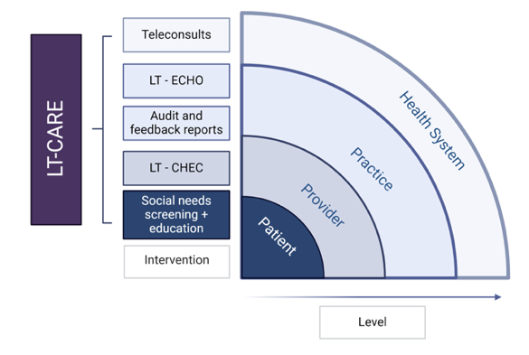
LT-CARE (Liver Transplant-Community Access for Referral Equity) Pilot Study
The long-term goal of this project is to engage with a diverse group of community partners to develop LTCARE, a multicomponent referral toolkit to address barriers at the health system, provider, and patient level and improve equity in LT referral. –Funded NIMHD R21

Slide 34
Social Need Screening and Intervention
✔️ Improve time from referral to waitlisting by addressing SDOH barriers like travel distance, income, and health literacy.
Choose a social need screening tool
Evaluate pre-intervention evaluation completion time; disaggregated
Outline a 5-year plan to close gaps by 10%
Incentivize

Slide 35
African American Transplant Access Program
Distrust
Our team takes the time to build a trusted, valued relationship with each patient and their family
Cultural competency
We embrace the unique, rich culture and experience of Black Americans, and bring openness, understanding, and willingness to learn to every patient encounter
Psychosocial support
Transplant care goes beyond the operating room. We have a team in place to help connect patients and families with the resources they need, from insurance assistance to support groups
Since 2019
150 referrals
56% increase in evaluations
18% increase in listing
Health Literacy
We offer education about diagnosis and treatment in language that is easy to understand, and we take the time to answer questions so that patients and families feel comfortable about each step of the transplant journey
https://www.nm.org/conditions-and-care-areas/organ-transplantation/african-american-transplant-access-program
https://www.healio.com/news/nephrology/20220411/african-american-transplant-access-program-creates-change-in-chicago

Slide 36
Conclusions
✔️ Autonomy, beneficence, and non-maleficence are coded into practice in healthcare and transplant, why not justice?
✔️ Gender, race, and SES disparities are prevalent at every step in the care journey, and insurance is necessary but not sufficient to fix the problem.
✔️ Public Perception of Injustice drives a cycle of disengagement that impacts the marginalized and the majority.
✔️ I imagine a system with smart regulations facilitate community-engaged solutions.

Slide 37
NIMHD R21

Slide 38
Questions

