Slide 1
Return of Individual Research Results: Ethics and Regulation: The IU Approach Translational Research Ethics – Applied Topics (TREATs) Bioethics and Subject Advocacy Program, Indiana CTSI March 14, 2024
Peter H. Schwartz, MD, PhD
Director, IU Center for Bioethics
Director, Bioethics and Subject Advocacy Program, Indiana CTSI
Professor of Medicine and Professor of Bioethics, IU School of Medicine
Professor of Philosophy, IU School of Liberal Arts, IUPUI

Slide 2
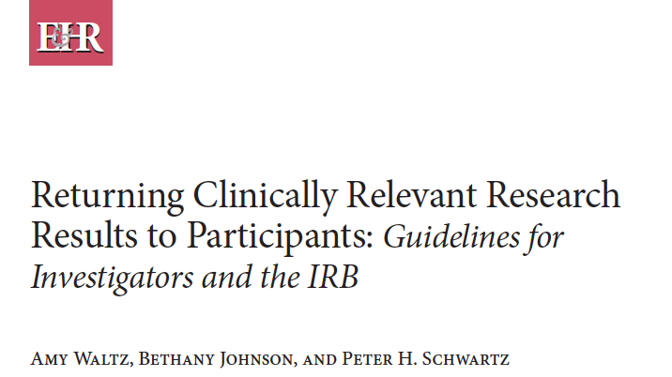
Conflict of Interest and Acknowledgements
Conflict of Interest and Acknowledgements
I have no conflicts of interest to report.
Special thanks to Amy Waltz, Bethany Johnson, and the other members of the IRB working group that developed the IU guidelines.

Slide 3
Traditional view
Healthcare vs. Research
Patient vs. Research “subject” (participant)
Goal of activity
Healthcare: Treatment and prevention
Research: Scientific and medical progress
Responsibility towards the individual
Healthcare: Improve or protect health of the patient
Research: Minimize or avoid harm to the participant
Reason for the individual to participate:
Patient: Improve health (self-oriented)
Research participant: Benefit future patients (other-oriented, altruism)

Slide 4
Return of results
Types of findings:
Primary
Secondary
Incidental
Any of these results can have important implications for patient health: E.g.,
Genetics, e.g. BRCA1
Xray/ radiology, e.g. brain tumor
Lab tests, e.g. potassium 7
PHQ9 (depression score), e.g. suicidality

Slide 5
Traditional view
Do not return results to individuals, since research particpants are not patients, and the project goal is research not healthcare.
Only (possible) exception: Safety issues (e.g. potassium of 7 or suicidality), which are generally disclosed to healthcare providers
Explicit statement included in informed consent that the participant will not receive any results.

Slide 6
Key Changes
Reconsideration of ethical issues:
Is withholding potentially useful information a form of harm?
Duty of rescue: E.g., you are running for exercise tomorrow and see a child about to walk into the street. Many believe you have an obligation to try to stop him, due to the great benefit to him and minimal risk or burden on you.
Blurring the line between healthcare and research
Research that involves clinical care; e.g., Clinical trials
Healthcare that also serves as the basis for research; e.g., retrospective studies
Changing view of research participant
“Subject” → Participant (active partner)
Community based participatory research (CBPR)
Reimbursement of participants

Slide 7
Genetics: Clinical setting
American College of Medical Genetics and Genomics (2013): When whole genome or exome sequencing is being performed clinically, 81 genes should always be tested, and the presence of any “actionable” variants should be disclosed to patients.
E.g. BRCA
Independent of the reason for testing.
Allow patients to opt out
How apply to the research setting?
Geisinger’s MyCode biobank
Focus groups
Resulting guidelines

Slide 8
Update in common rule (2016)
Informed consent document should include:
“A statement regarding whether clinically relevant research results, including individual research results, will be disclosed to subjects, and if so, under what conditions.” (45 CFR 46.116(c)(8))

Slide 9
Four types of research findings (“bins”)
Significant for the person’s health in the near future, potentially involving risk of death or severe morbidity, and interventions are available that improve outcomes.
Significant for the person’s health but not in the near future, and interventions are available that improve outcomes.
Significant for the person’s health but there are no interventions available that improve outcomes.
Unclear significance for the person’s health, and no interventions that improve outcomes.

Slide 10
Four types of research findings (“bins”)
Significant for the person’s health in the near future, potentially involving risk of death or severe morbidity, and interventions are available that improve outcomes.
Significant for the person’s health but not in near future, and interventions are available that improve outcomes.
Significant for the person’s health but there are no interventions available that improve outcomes.
Unclear significance for the person’s health, and no interventions that improve outcomes.
Benefits of disclosure:
Medical
Personal
Risks of disclosure
Misuse
Anxiety
As you go down the list:
Decreasing benefits
Increasing possibility of misuse

Slide 11
Four types of research findings (“bins”)
Significant for the person’s health in the near future, potentially involving risk of death or severe morbidity, and interventions are available that improve outcomes.
Significant for the person’s health but not in near future, and interventions are available that improve outcomes.
Significant for the person’s health but there are no interventions available that improve outcomes.
Unclear significance for the person’s health, and no interventions that improve outcomes.
Must disclose to participants or providers
Should disclose to participants or providers
May or may not disclose to participants or providers
Should not disclose to participants or providers

Slide 12
Important caveats and considerations
Limitations of resources, effort, and expertise.
Not ethically required to look for findings that might be relevant to research participants. No “duty to hunt,” even for Bin 1 or 2 results.
May choose to obtain and return results as part of inducement to participation
Consider benefits and risks of disclosure

Slide 13
Important caveats and considerations
Patients must be asked for consent:
Explain system for return of results.
Planning system for return of results:
Who: Researcher, clinician, genetic counselor
How: Explaining results and implications
Implications: How patients can receive follow-up care

Slide 14
Important caveats and considerations
Cannot return lab results that were obtained in a lab that is not CLIA certified.
Danger of returning results that are not clinically valid.
No ethical or regulatory requirement to have a licensed radiologist review all scans.
No obligation to return of results obtained during secondary analysis of research

Slide 15
Bottom line
Anticipate results that might be relevant to your participants health or desired by them.
Decide whether you will return those results, taking into consideration
Category of the results (Bins 1-4)
Benefits and risks
Process for return, resources required
Disclose plan during informed consent and allow participants to decide, at least for Bins 2-4.
IRB role

Slide 16
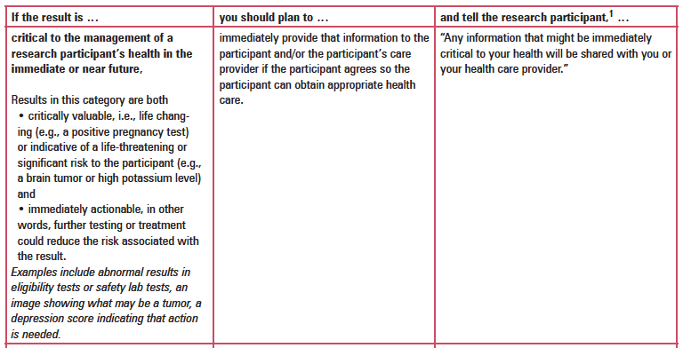
A table used for decision making

Slide 17
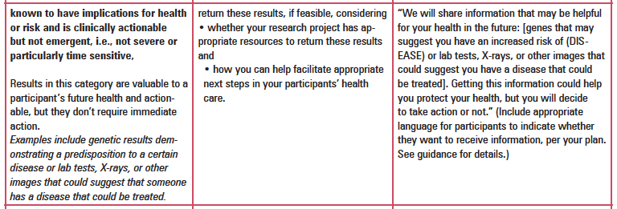
A table used for decision making

Slide 18
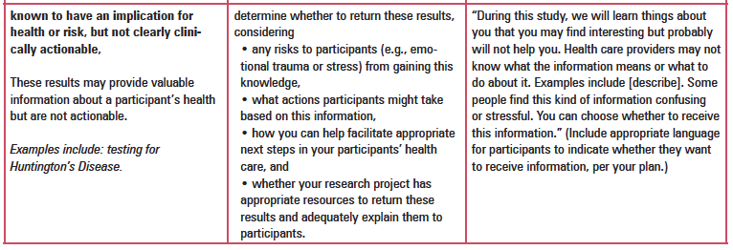
A table used for decision making

Slide 19
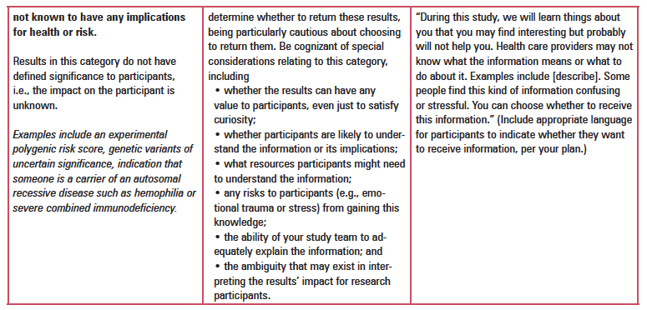
A table used for decision making

Slide 20
Resources
National Academies of Science, Engineering, and Medicine (NASEM) (2018), Return of Individual-Specific Research Results Generated in Research Laboratories,
https://www.nationalacademies.org/our-work/return-of-individual-specific-research-results-generated-in-research-laboratories
Multi-Regional Clinical Trials (MRCT) Center, Brigham and Women’s Hospital, Harvard (2017), Return of Individual Results,
https://mrctcenter.org/blog/projects/return-of-individual-results/

Slide 21
Resources
Free consultation from the
Bioethics and Subject Advocacy Program (BSAP) of the Indiana CTSI.
Webpage: https://bioethics.iu.edu/ethics-research/index.html
Request form: https://bioethics.iu.edu/ethics-research/request-consult.html
Email: phschwar@iu.edu or BSAP@iu.edu
Contact: Nic Oliver, MA, Program manager, olivnj@iu.edu

